Slide 1
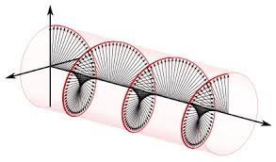
Group Meeting July 28th, 2021
Keith Foreman

Slide 2
Unpolarized Light Source
Nylon set screw
Teflon Tube
Teflon Washer
Nylon set screw
Light
(not to scale)
Cavity
Goose Neck
Ground Opal
Ground Opal
Aluminum

Slide 3
Unpolarized Light Source
$$\left(\begin{aligned}1 \\ −0.00191(23) \\ −0.00941(26) \\ 0.00072(11)\end{aligned}\right)$$
No Depolarizer
Light
Goose Neck
$$\left(\begin{aligned}1 \\ −0.00002(25) \\ −0.00052(24) \\ 0.00032(12)\end{aligned}\right)$$
Empty Depolarizer
$$\left(\begin{aligned}1 \\ −0.00240(26) \\ −0.00024(27) \\ −0.00024(13)\end{aligned}\right)$$
Filled
Depolarizer

Slide 4
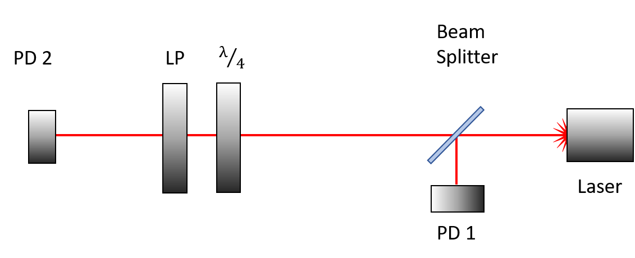
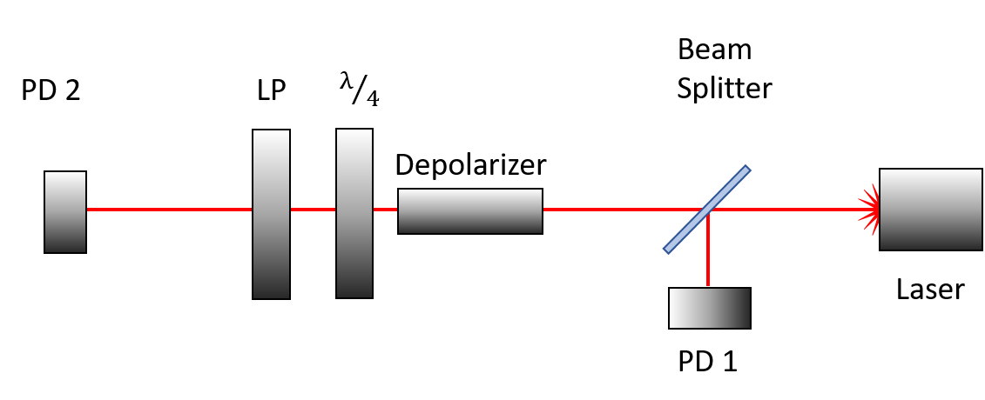
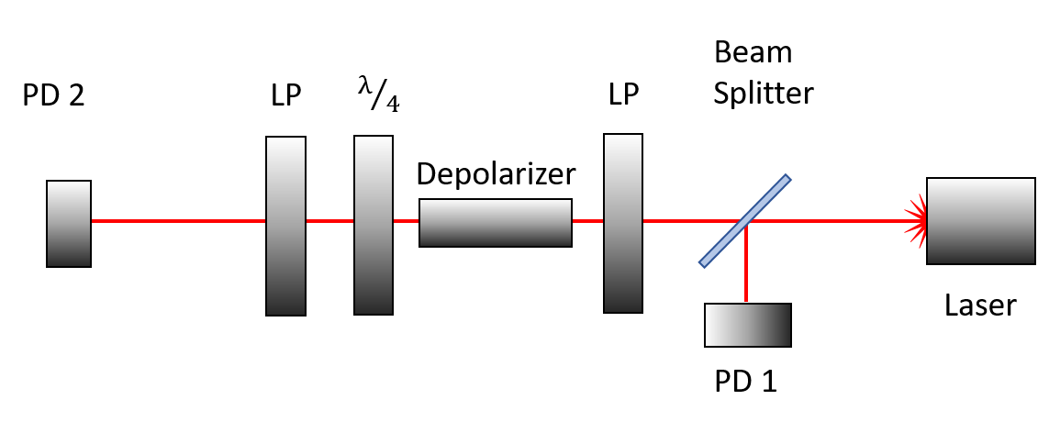
Depolarizer RSI
Depolarized Diode laser light (Rotated Depolarizer):
Diode laser light (with beam splitter):
Depolarized Diode laser light:
$$\left(\begin{aligned}1 \\ 0.961410(119) \\ −0.262847(34) \\ 0.079757(7)\end{aligned}\right)$$
$$\left(\begin{aligned}1 \\ 0.025961(10) \\ −0.014171(8) \\ −0.002379(4)\end{aligned}\right)$$
$$\left(\begin{aligned}1 \\ 0.022010(8) \\ −0.012516(7) \\ 0.001847(4)\end{aligned}\right)$$
Depolarized Polarized Light:
Parent Vector:
$$\left(\begin{aligned}1 \\ 0.020258(8) \\ −0.009282(8) \\ 0.003072(4)\end{aligned}\right)$$
$$\left(\begin{aligned}1 \\ 0.999512(6) \\ −0.000520(14) \\ 0.001280(11)\end{aligned}\right)$$

Slide 5
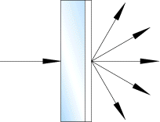
Depolarizer RSI
Blocking the beam in front of the PD with my hand
I’ve started writing an outline for the RSI paper.

Slide 6
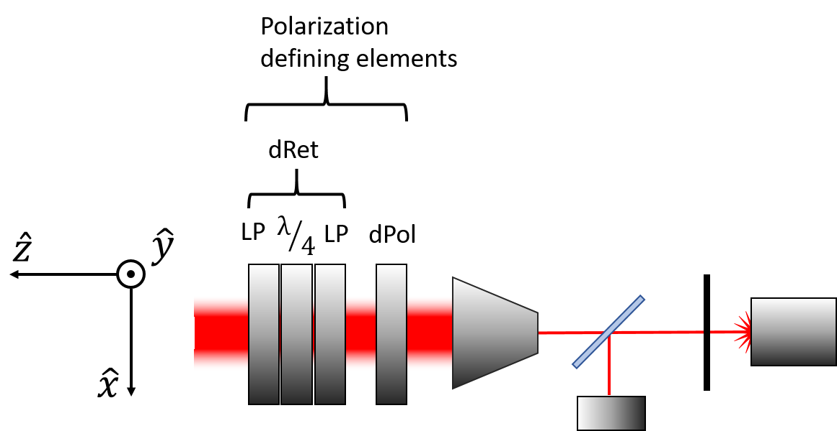
Analyzing Retarder’s k-value
Defining Polarizer (dpol)
Pass axis of defining polarizer = -7°
K-value of defining polarizer = 0.99984842
Defining Retarder (dret)
Weak polarizer 1 pass axis = θ1
Weak polarizer 2 pass axis = θ2
Weak polarizer K-value (same for both) = k
Fast axis = 15.5°
Retardance = 91.1908°

Slide 7
Analyzing Retarder’s k-value
= measured value

Slide 8
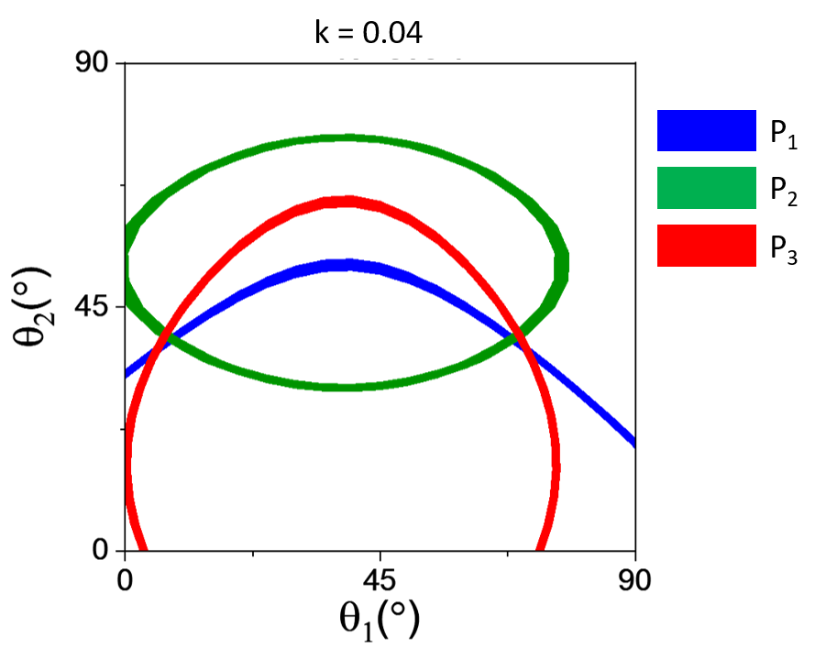
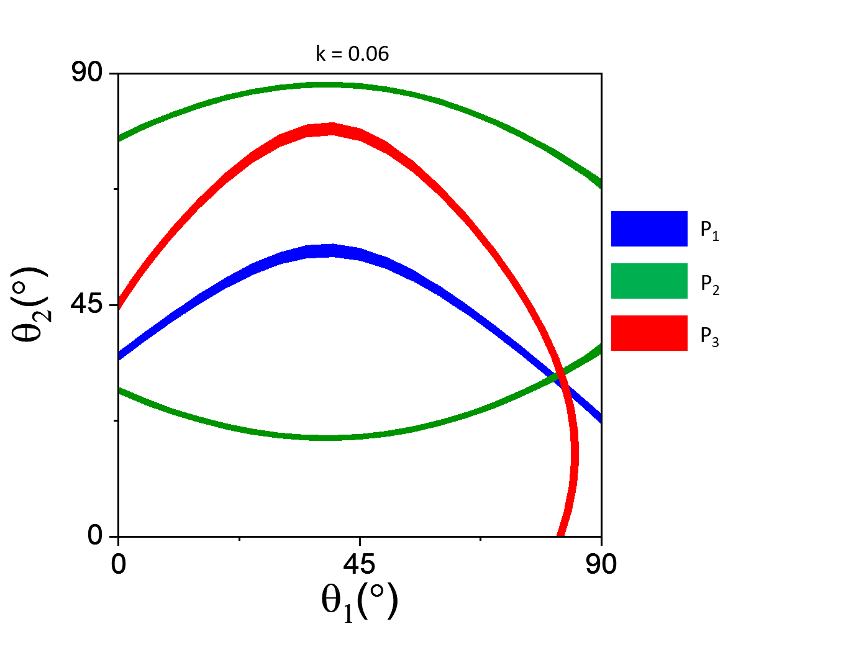
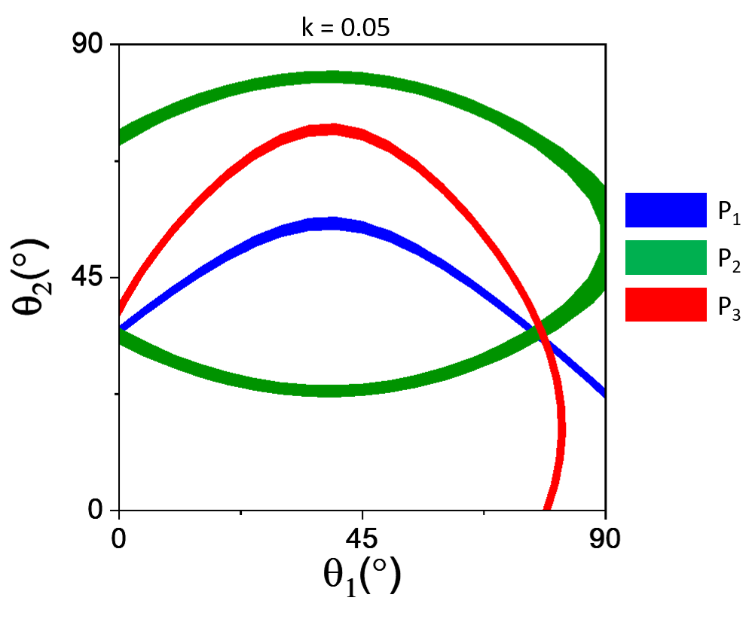
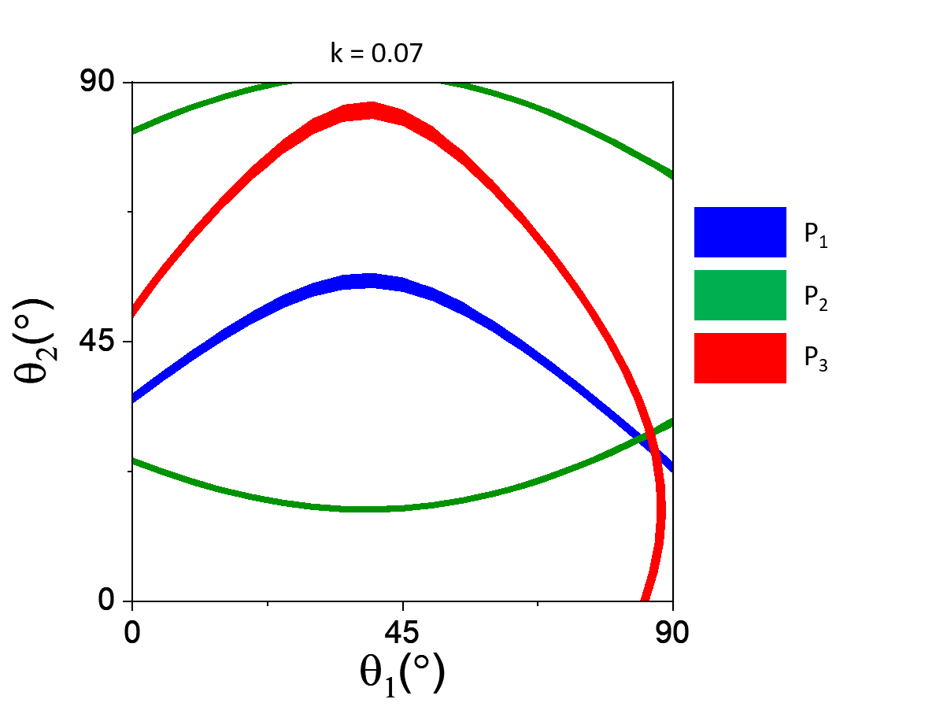
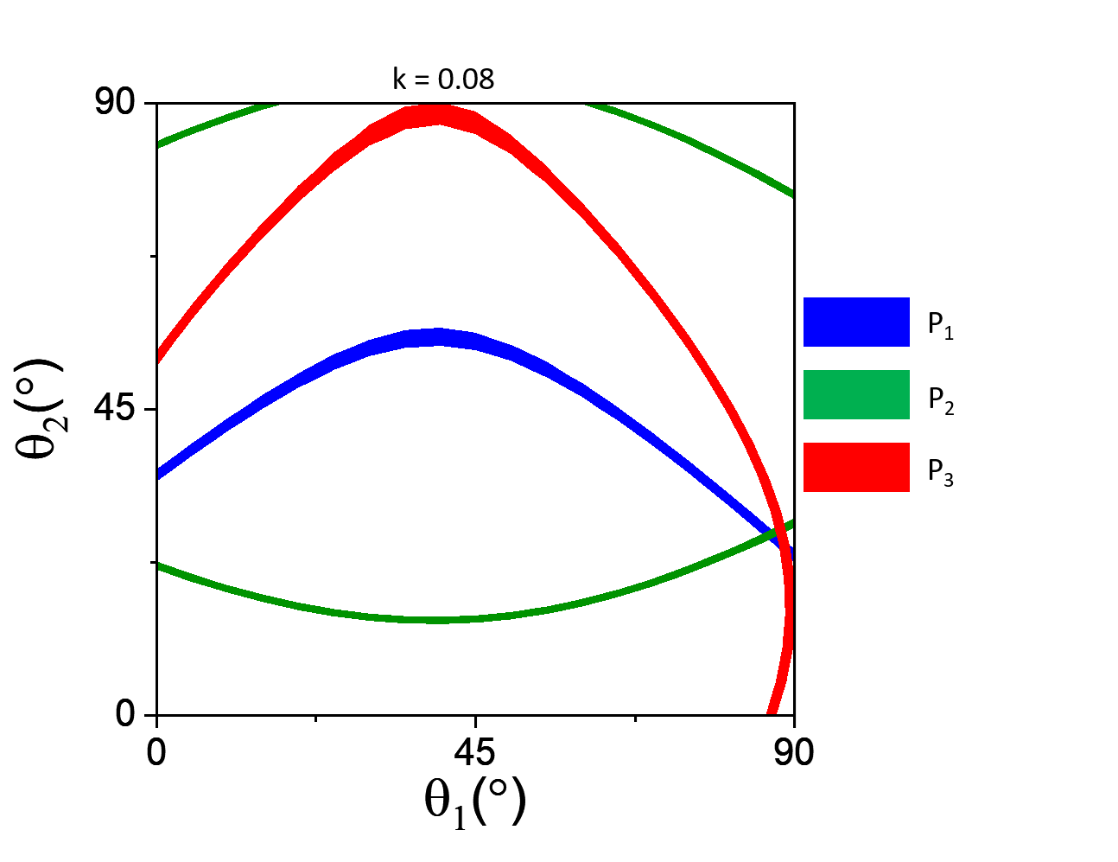
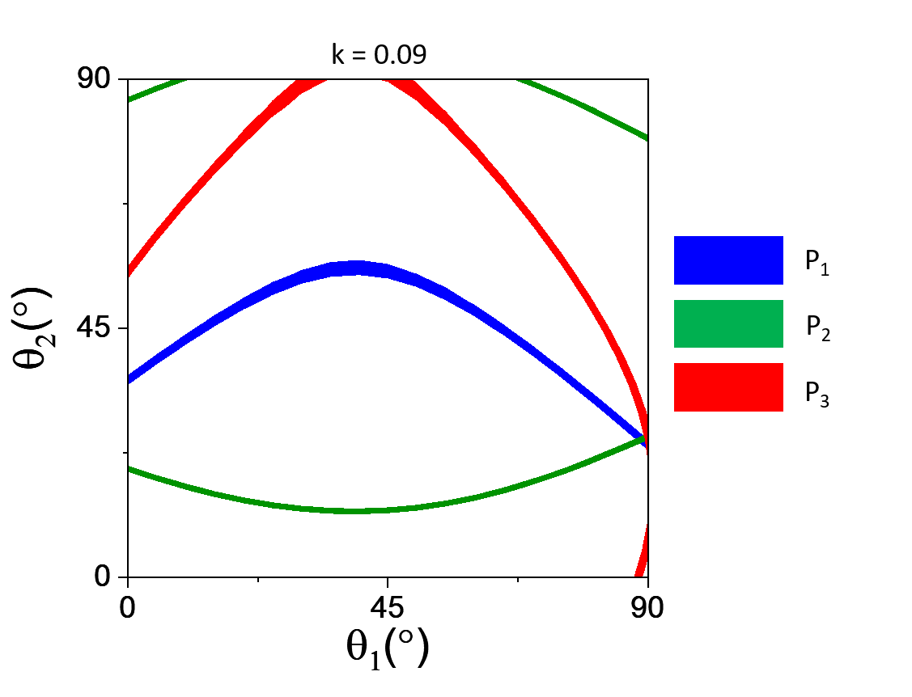
Analyzing Retarder’s k-value
Colored bands = measured value

Slide 9
Analyzing Retarder’s k-value
Modeling the retarders as weakly polarizing elements not only explains why we get different values of δ depending on the configuration of the optical train, but can also explain why the measured Stokes vector is different than the predicted Stokes vector.
k = 0.04
0.04
0.06
We can put rough bounds on the k-value of the retarder glass:
0.04 < k < 0.09
0.05
0.08
0.07
0.09

Slide 10
Analyzing Retarder’s k-value
Malus’ Law for one perfect and one imperfect polarizer:
DC Signal (picoammeter)
AC Signal (chopper and lock-in)
For what it’s worth, these fits would correspond to a k-value of ~0.001

Slide 11
Analyzing Retarder’s k-value

