Slide 1
Demonstration of a sub-Poissonian free electron emitter
Sam Keramati*, Will Brunner, T. J. Gay, Herman Batelaan**
Department of Physics and Astronomy,
University of Nebraska-Lincoln, USA
APS Conference DAMOP – June 3, 2020
* sam.keramati@huskers.unl.edu
** hbatelaan@unl.edu
We acknowledge support by the National Science Foundation (NSF) & the Nebraska Research Initiative (NRI).
1/16

Slide 2
(a)
(b)
F
P₁
1
P₂
1
2
F
2
Aperture
Aperture
Ultrafast electron emission from nanotip sources has been widely investigated in recent years
The statistical distribution of photoelectrons (#e/pulse) from nanotip emitters has not been studied
Relevant to ultramicroscopy; material characterization; & fermionic Hanbury Brown-Twiss experiment with ultrashort pulsed electron beams [→ S. Keramati, E. Jones, J. Armstrong, and H. Batelaan, in Advances in Imaging and Electron Physics (Elsevier, 2020), Vol. 213.]
(Pauli 'force', quantum mechanical antibunching signal)
2/16

Slide 3
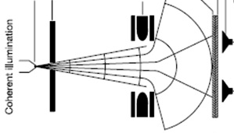
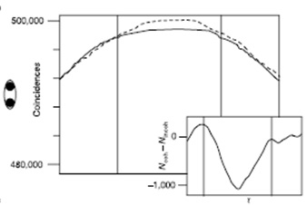
(a)
(b)
F
P₁
1
P₂
1
2
F
2
Aperture
Aperture
1
2
[H. Kiesel, A. Renz, and F. Hasselbach, Nature 418, 392 (2002)]
3/16

Slide 4
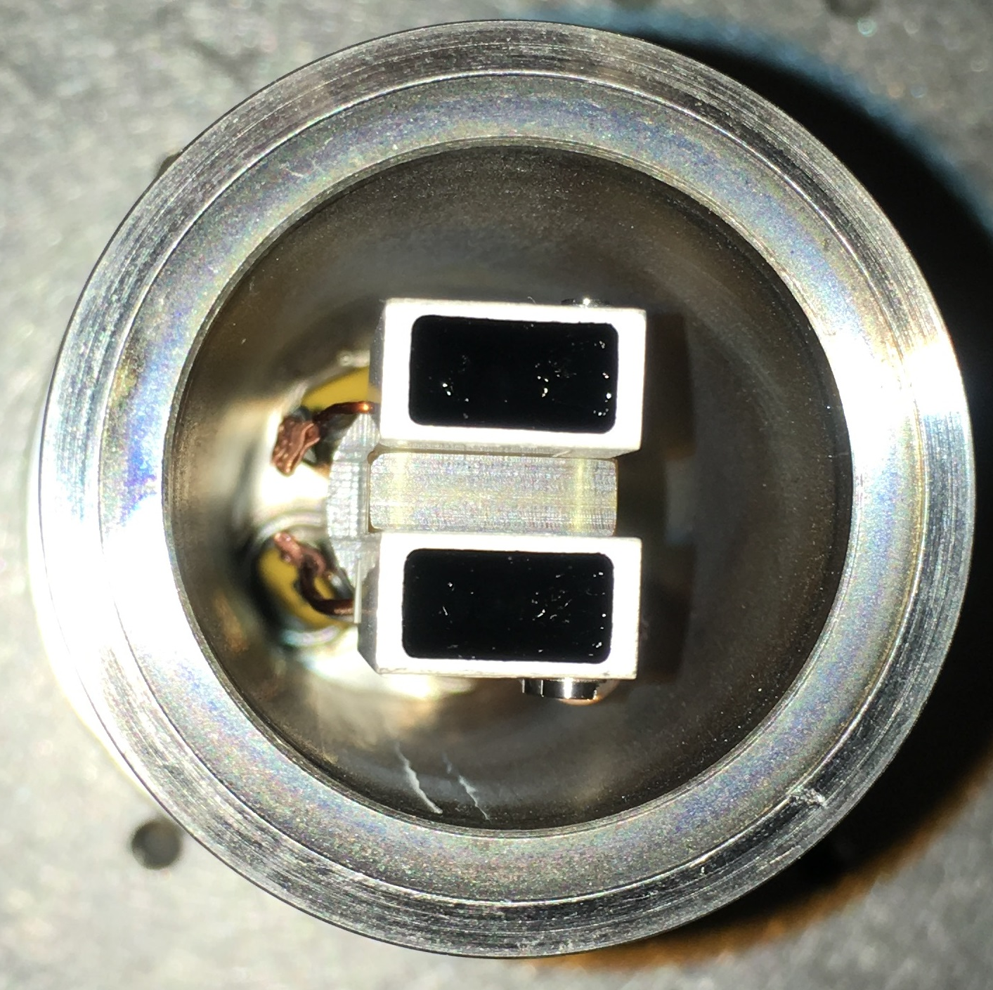
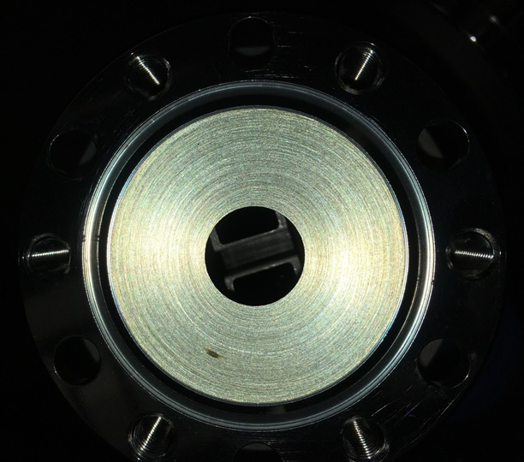
3.4 cm
1.4 cm
(a)
(b)
F
P₁
1
P₂
1
T₀ = 13.2 ns
TOF = 8 ns
2
F
2
Aperture
Aperture
Ti:Sa oscillator: 76 MHz – 100 fs – 800 nm – 1 nJ/pulse (I_{p} ~ 10 GW/cm²) – H polarized
W nanotip
500 nm
V_{tip} = -100 V
pressure 2×10 ⁻⁷ Torr
channeltrons
Dr. Sjuts KBL 510
4/16

Slide 5
Schematic of the coincidence electronics
counts
t
coincidence
counts
τ
counts
t
5/16

Slide 6
coincidence
counts
T₀ = 13.2 ns
τ
0
T₀
Start
100 fs
1
tip
e
e
2
e.g. P₀ = 90% , P₁ = 9% , P₂ = 1%
P₁× P₁ = 0.8%
Stop
6/16

Slide 7
coincidence
counts
T₀ = 13.2 ns
τ
-2T₀
0
T₀
Start
100 fs
1
tip
e
e
2
e.g. P₀ = 90% , P₁ = 9% , P₂ = 1%
P₁× P₀ × P₁ = 9% × 90% × 9% = 0.7%
Stop
7/16

Slide 8
coincidence
counts
T₀ = 13.2 ns
τ
0
T₀
Start
100 fs
1
tip
e
e
2
e.g. P₂ = 1%
Stop
8/16

Slide 9
coincidence
counts
T₀ = 13.2 ns
τ
0
Start
100 fs
1
tip
e
e
2
Stop
9/16

Slide 10
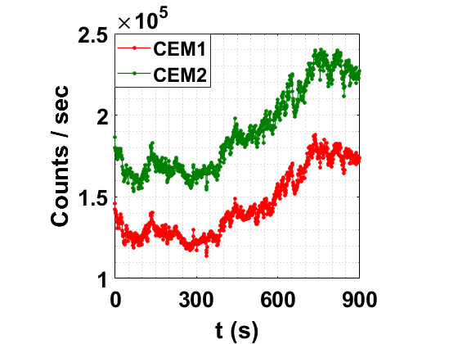
-3T₀
-2T₀
-1T₀
0
+1T₀
+2T₀
+3T₀
10/16

Slide 11
0
+1T₀
+2T₀
11/16

Slide 12
SIMION simulation:
pulsed Poissonian source
ΔE = 1 eV – no Coulomb
peak widths fitted to data using
a set of Gaussian profiles
12/16

Slide 13
A
tip
the probability to detect at least 1 electron in the start detector
the probability to detect zero electrons in the stop detector over the time interval (n-1)T₀
the probability to detect at least 1 electron in the stop detector
the total number of time intervals separated by nT₀
B
Poisson
T₀
T₀
T₀
T₀
A
B
13/16

Slide 14
Conclusion:
λ = 1.901 → P₀ = 14.94%
0T₀
1T₀
λ = 0.001 → P₀ = 99.90%
R₀₁ = 1.001
14/16

Slide 15
Summary:
Ultrafast photoemission from a W nanotip was shown to be sub-Poissonian
This was observed for both a sharp (r = 50 nm) and broad (r = 400 nm) tip
What to expect in the fermionic HBT experiment with quadrupole turned off
Candidate mechanism: 1. Coulomb repulsion in multi-electron pulses (likely) 2. Pauli force (not likely) 3. Material properties such as details of the W band structure, attractive force by the positive ion left behind for a few fs, Pauli blockade in the tip just before emission, etc. (may be)
15/16

Slide 16
Thank you!
Contact info:
Prof. Herman Batelaan: hbatelaan@unl.edu
Sam Keramati (postdoc): sam.keramati@huskers.unl.edu
Department of Physics and Astronomy
University of Nebraska-Lincoln, USA
June 3, 2020
16/16

