Slide 1
A High Precision
5 MeV Mott Polarimeter
Jefferson Lab Mott Team
J. M. Grames¹, C. K. Sinclair¹, M. Poelker¹, X. Roca-Maza²,
M. L. Stutzman¹, R. Suleiman¹, Md. A. Mamun¹, M. McHugh³,
D. Moser¹, J. Hansknecht¹, B. Moffit¹, and T. J. Gay⁴
¹Thomas Jefferson National Accelerator Facility
²Departimento di Fisica, Universita degli Studi di Milano, and Istituto Nazionale di Fisica Nucleare
³Physics Department, George Washington University
⁴Jorgensen Hall, University of Nebraska
SPIN2021, 17-22 October 2021, Matsue, Japan

Slide 2
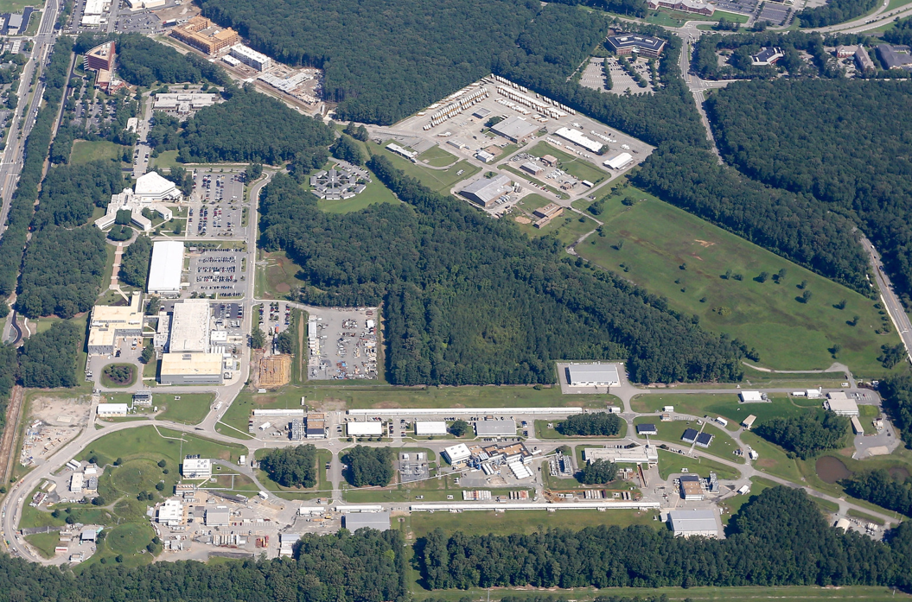
CEBAF @ Jefferson Lab
Many of the highest impact experiments performed at Jefferson Lab have relied on spin-polarized electron beams.
Users: 1500 (230 Institutions/30 Countries)
Multiplicity: 4 Halls (simultaneously)
Beam Polarization: >85%
Beam Energy: 11 GeV (ABC) / 12 GeV (D)
Beam Power: 1 MW (85 μA @ 11 GeV)
Cryogenics: Two 4.5 kW plants @ 2.1 K
HAPPEX – Nucleon strangeness
K.A. Aniol, et al., Phys. Rev. C 69, 065501 (2004)
K.A. Aniol, et al., Phys. Lett. B 635, 275 (2006)
K.A. Aniol, et al., Phys. Rev. Lett. 96, 022003 (2006)
G⁰ – Nucleon strangeness
D. S. Armstrong, et al., Phys. Rev. Lett. 95, 092001-1-5 (2005)
Q_{weak} – Test of Standard Model
D. Androic, et al., Phys. Rev. Lett. 111, 141803 (2013)
PREx – Neutron radius
C. Horowitz, et al., Phys. Rev. C 63, 025501 (2001)
G_{E}/G_{M} – Proton electric/magnetic factor
A. J. R. Puckett, et al., Phys. Rev. C 96 (2017) 055203
CREx – Calcium radius
See SPIN2021 talk

Slide 3
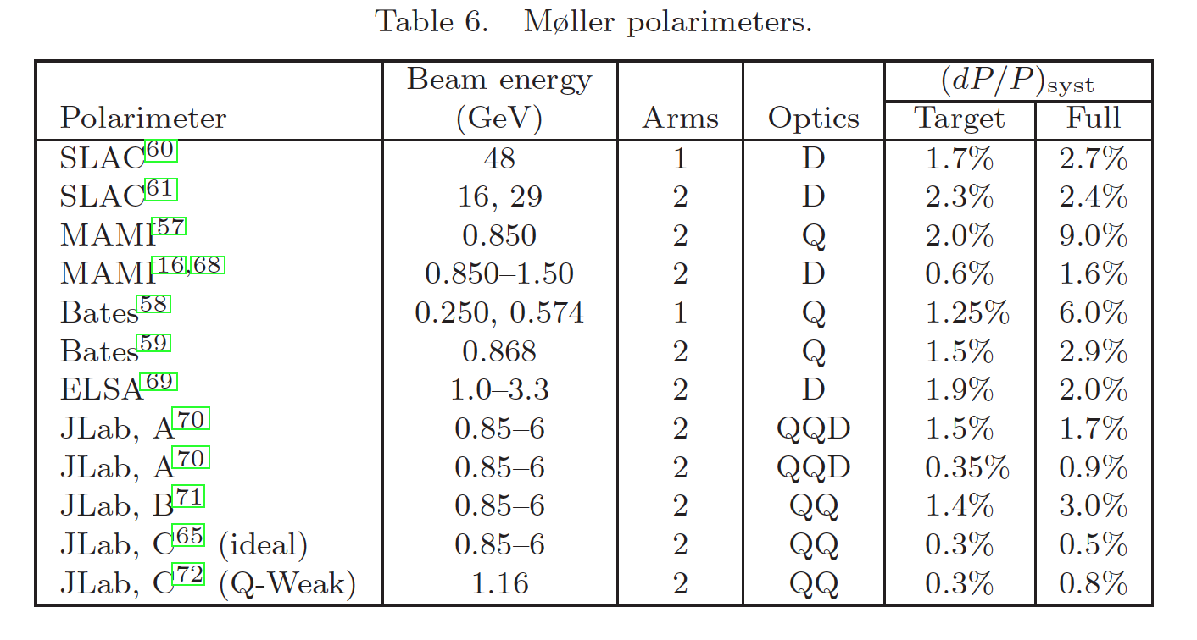
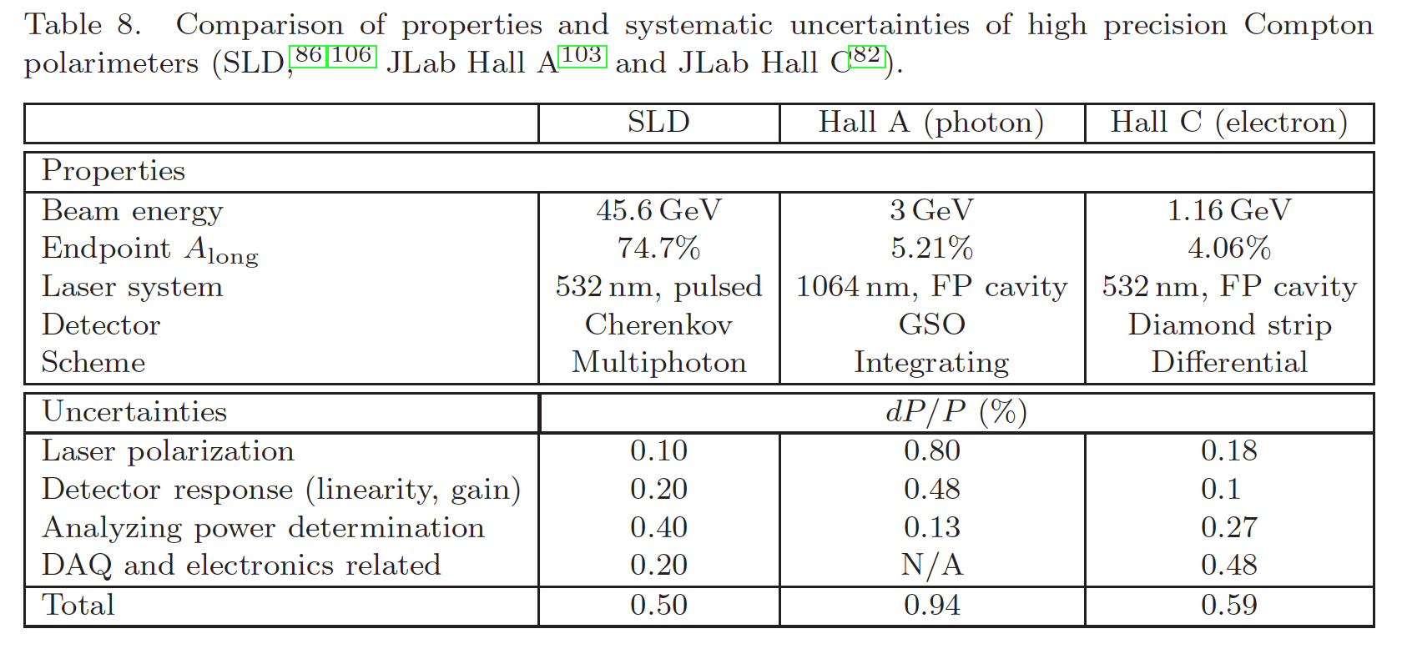
High energy electron polarimeters at CEBAF
Unsurprisingly electron polarimetry is a very important technology at Jefferson Lab, and there are many polarimeters.
K. Aulenbacher, E. Chudakov, D. Gaskell, J. Grames, and K.D. Paschke,
"Precision electron beam polarimetry for next generation nuclear physics experiments",
International Journal of Modern Physics E, 27, 7 (2018)

Slide 4
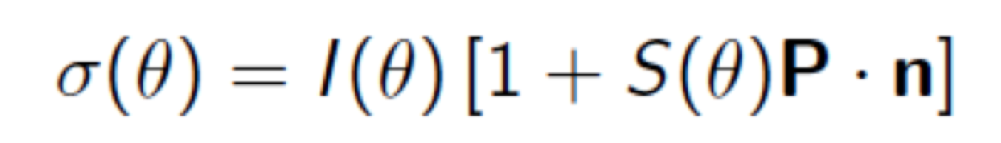
Injector MeV energy Mott scattering polarimeter
Mott polarimetry exploits elastic scattering asymmetry of spin polarized electrons from nuclear Coulomb field.
Benefits over traditional keV Mott polarimeters
Larger analyzing power
Smaller cross-section
Free standing targets
Systematics greatly suppressed (more on this)
Historical performance
Measuring spin-polarization of photocathodes
Calibrating injector spin rotators
Study 20 years ago reports 1.1% accuracy (conservatively 1-2%)

Slide 5
High precision Mott polarimetry
The dominant uncertainty in the measured parity-violating asymmetry in the scattering of longitudinally polarized electrons from nuclear or electron targets is on the beam polarization.
Next generation of parity-violations experiments are significantly more demanding
  <1% for Moller: e⁻ - H (JLab)
  <0.5% for P2: e⁻ - H (MESA)
  <0.5% for SoLID/PV-DIS: e⁻ - ²H (JLab)
In support of the Jefferson Lab mission to achieve <0.5% precision we embarked on a multi-year strategy to test the Mott polarimeter

Slide 6
Our strategy for a precision of the MeV energy Mott polarimeter
Careful selection of elastic events originating only from the target
Precise characterization of beam and instrumental uncertainties
Improving extrapolation to a single-atom of zero thickness
Modern arguments on the single-atom Sherman function
Test what we learned with further techniques & measurements
(thick)
Sherman function (theory)
(thin)
Target thickness extrapolation (simulation & analysis)
Effective Sherman Function (S_{eff})
Measured asymmetry (statistical + instrumental)
Target Thickness

Slide 7
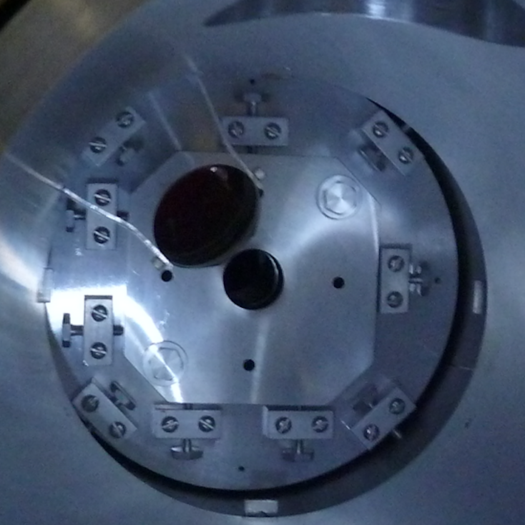
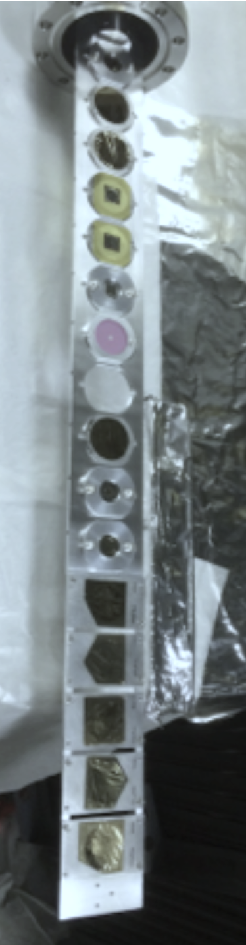
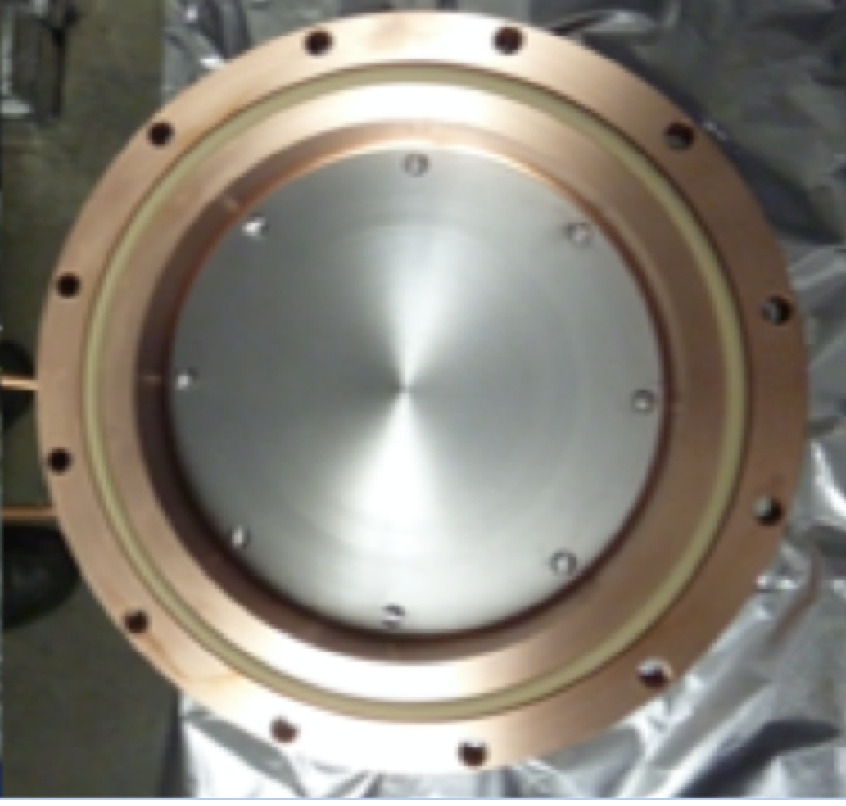
Step 1 – Improve and prepare Mott scattering chamber
Checked and repaired each detector package, comprised of E (e-) and dE (photon veto) detector
Re-surveyed adjustable collimator system
Loaded 10 gold foils, each with a sibling for thickness measurement
Replaced Al dump with Be plate to reduce e- backscatter and Cu radiator end flange

Slide 8
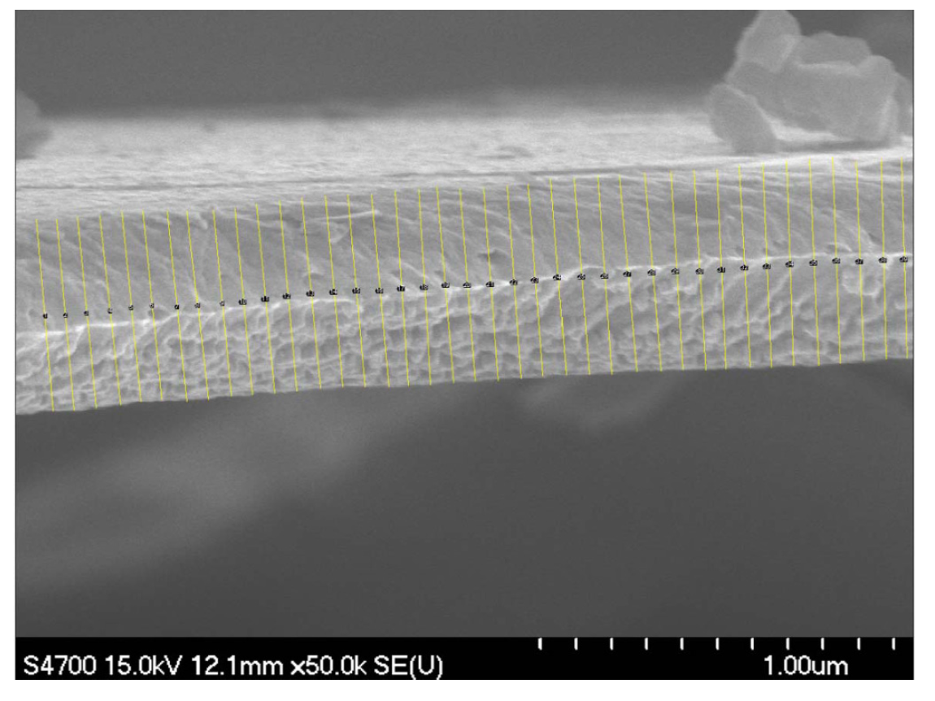
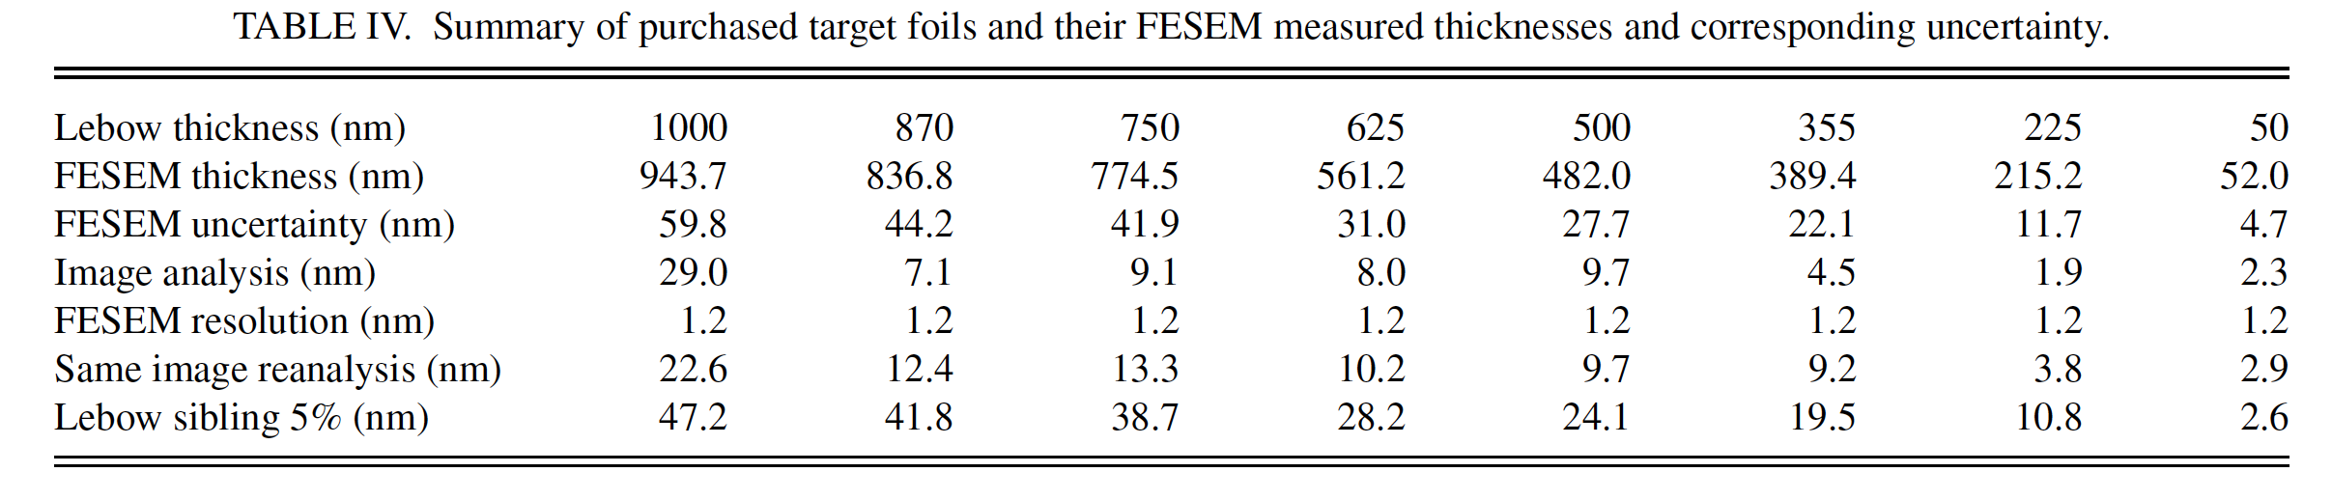
Step 1 – Improve and prepare Mott scattering chamber
Used 10 foils used with nominal thicknesses ranging from 50 nm to 1000 nm, with duplicates at 50 and 350 nm
Measured thickness of sibling foils (destructive) using Field Emission Secondary Electron Microscopy
Uncertainties due to FESEM resolution & reproducibility, variation across sample and imaging
Thickness consistent with vendor (Lebow in Chicago)

Slide 9
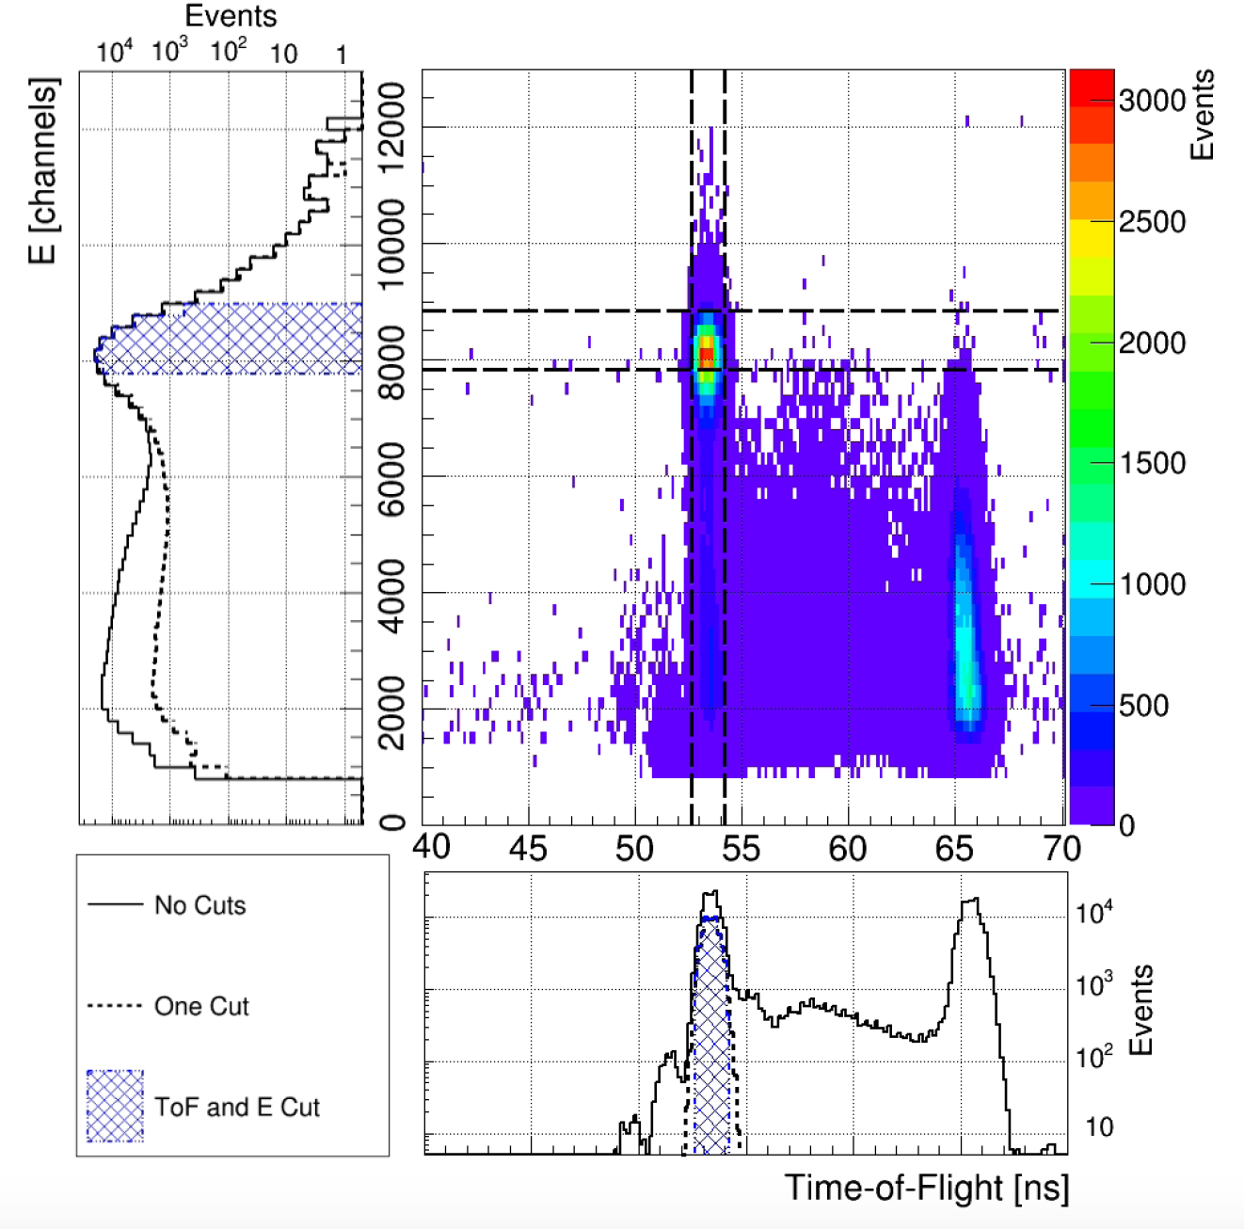
Step 1 – Fine tune the Data Acquisition & Analysis Chain
Data acquisition system collects coincidence event data
Flash ADC samples energy spectra (<10 kHz)
Timing resolution 34 psec, width of peak 380 psec
Beam helicity & current are sampled, tagged to events
Event data analyzed off-line in three step process (described in gory detail in PRC article)

Slide 10
Step 2 – Precise characterization of beam and instrumental systematics
Sensitivity to beam size
Sensitivity to beam position
Sensitivity to beam current
Reproducibility
Slow helicity reversal

Slide 11
Step 2 – Precise characterization of beam and instrumental systematics
Sensitivity to beam size
Sensitivity to beam position
Sensitivity to beam current
Reproducibility
Slow helicity reversal

Slide 12
Step 2 – Precise characterization of beam and instrumental systematics
Sensitivity to beam size
Sensitivity to beam position
Sensitivity to beam current
Reproducibility
Slow helicity reversal

Slide 13
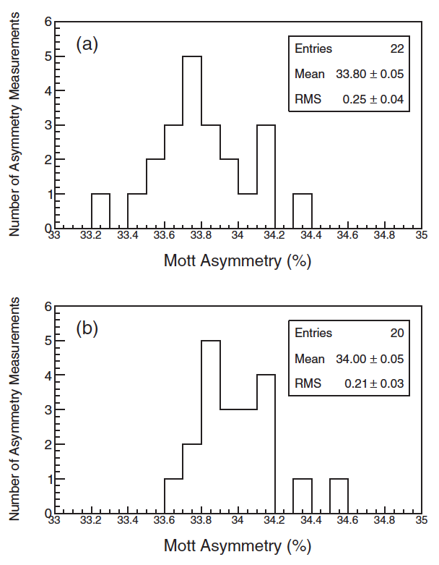
Step 2 – Precise characterization of beam and instrumental systematics
Sensitivity to beam size
Sensitivity to beam position
Sensitivity to beam current
Reproducibility
Slow helicity reversal

Slide 14
Step 2 – Precise characterization of beam and instrumental systematics
Sensitivity to beam size
Sensitivity to beam position
Sensitivity to beam current
Reproducibility
Slow helicity reversal
Half of data collected with a λ/2 waveplate IN or OUT.
Statistical ratio for all measurements
  Run1 1.0022 +/- 0.0020
  Run2 1.0017 +/- 0.0021
Laser polarization >99.8 +/- 0.1 %

Slide 15
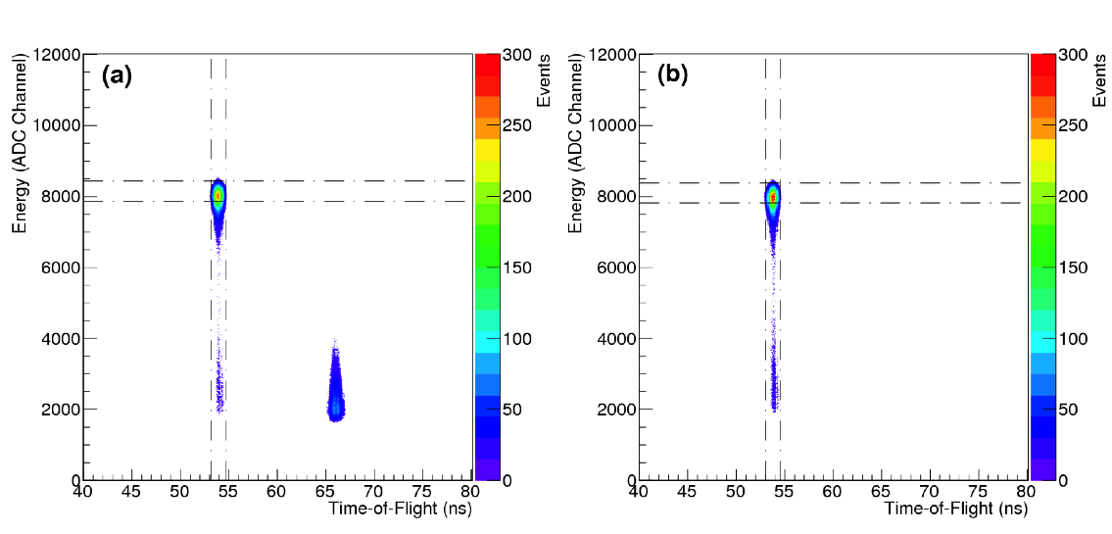
Step 3 – Improving zero thickness extrapolation
Experiment was done twice, with more than a year??? in between
Run 1
GaAs/GaAsP #1
Spin vertical => L/R detectors
Timing cut (analysis)
Run 2
GaAs/GaAsP #2
Spin horizontal => U/D detectors
Timing veto (hardware)

Slide 16
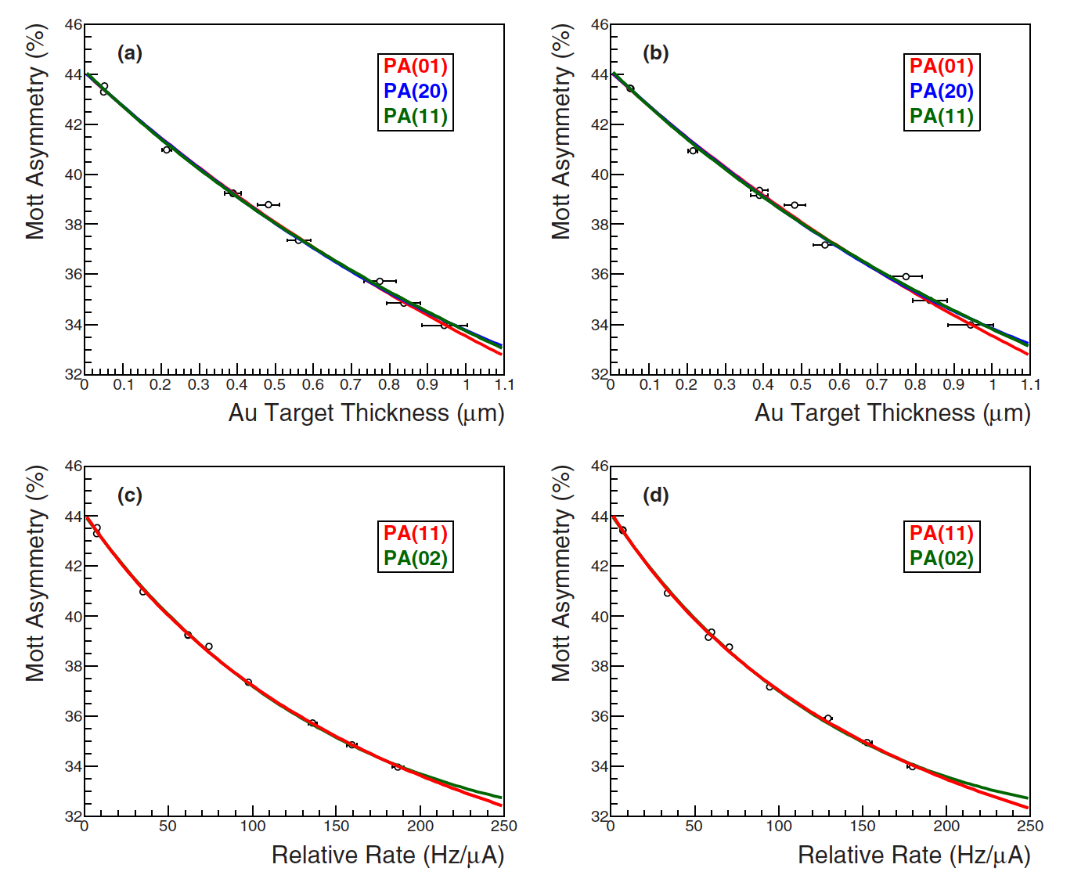

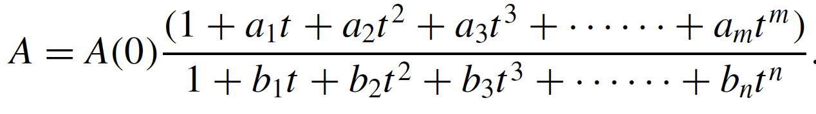
Step 3 – Improving zero thickness extrapolation
No known precise functional form to account precisely for multiple-elastic scattering
Instead we apply of Pade approximates to determine the statistically allowed polynomial
An advantage of also using relative scattering rate is the high statistical precision due to the very well known beam currents used
Purely single –
And double –

Slide 17
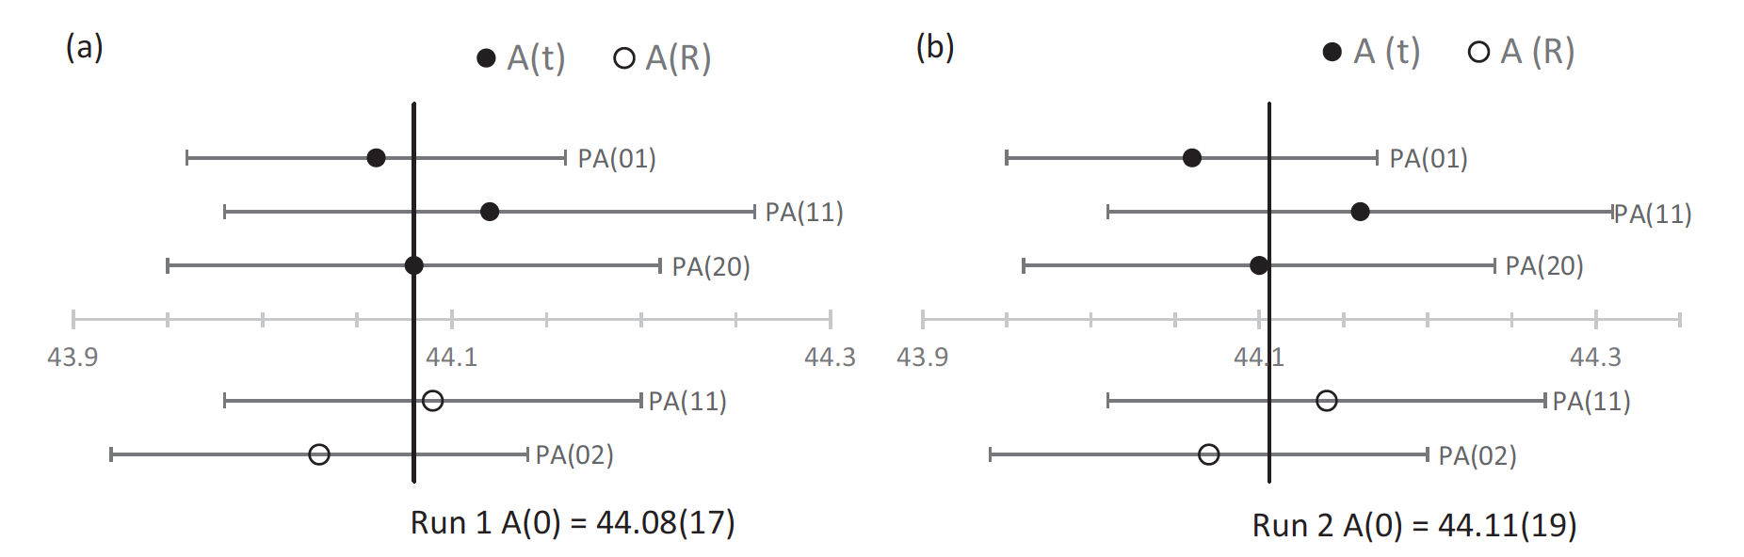
Step 3 – Improving zero thickness extrapolation
Pade analysis rejects fits based on poor reduced chi-squared values and outcomes of F-tests
Good agreement with most forms traditionally used (1,0) (0,1) (1,1) (0,2) (2,0)
Our final result average over all accepted fits based on the statistical analysis (no biasing)
P(e-) = 85.72 ± 0.19%
P(e-) = 85.72 ± 0.21%

Slide 18



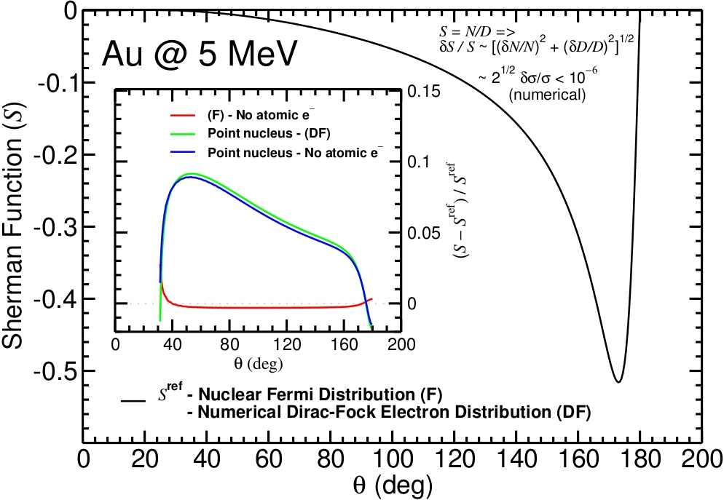
Step 4 – Single-atom Sherman function
See X. Roca-Maza Eur. Phys. Lett. 120 33002 (2017) &
Salvat F., Jablonski A. and Powell C. J., Comput. Phys. Commun., 165 (2005) 157.
Relativistic (Dirac) partial-wave calculations from a local central interaction potential V(r)
Scattering amplitudes (f and g) and dσ/dΩ are estimated from the convergence of the partial-wave series, typically smaller than 10⁻⁶
solution
Effects in the Sherman function S(θ):
ρch → Vcoul(r) ~0.1% depends on using a realistic Nuclear Model
Electron exchange potential Vex(r) is ~few %0 if neglected
Inelastic contributions Wabs(r) <0.1% if neglected
Screening from atomic electrons few % if neglected
Radiative corrections do not amount to more than a 0.5% (estimated!).
X. Roca-Maza

Slide 19
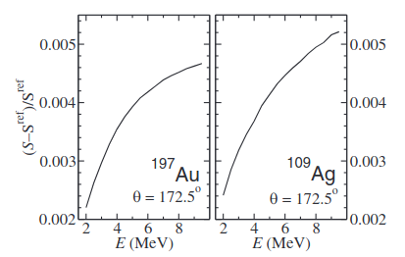
Step 4 – Single-atom Sherman function
Radiative corrections give the largest contributions to the theoretical uncertainty in the Sherman function in the few-MeV energy range.
X. Roca-Maza Eur. Phys. Lett. 120 33002 (2017)
Leading QED corrections of the order of α²Z are the self-energy (left) and vacuum polarization (right). Both increase with energy and Z.
Measuring the Mott asymmetry from foils of different Z and with different Energy bounds the theoretical uncertainty.

Slide 20
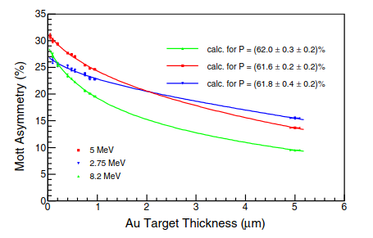
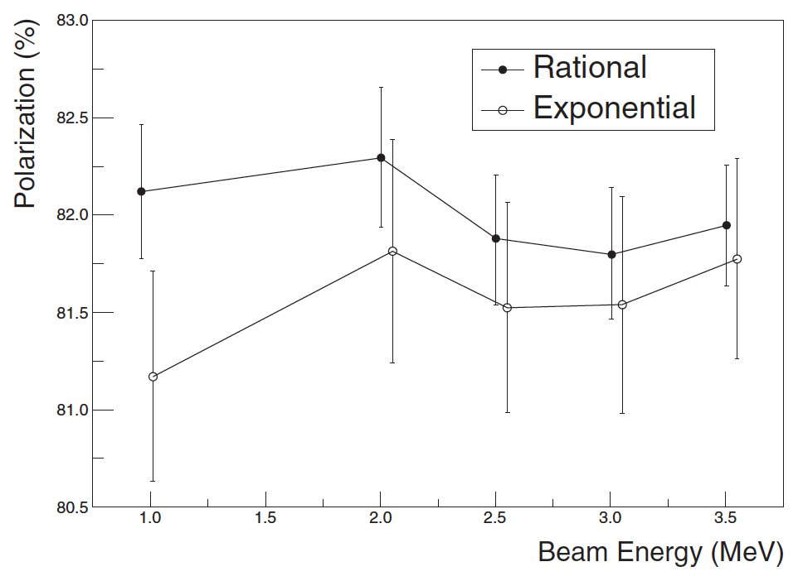
Step 4 – Single-atom Sherman function
Experimental evidence supports the net effect of these corrections largely cancels (as theoretically anticipated).
M. Steigerwald, SPIN2000
AIP Conf. Proc. No. 570, p. 935.
V. Tioukine, K Aulenbacher, and E. Riehn,
Rev. Sci. Instr. 82, 033303 (2011)
At the energies of interest only experimental evidence radiative corrections < 0.5%
* No radiative corrections were included in the analysis of the Sherman function at these three energies.

Slide 21
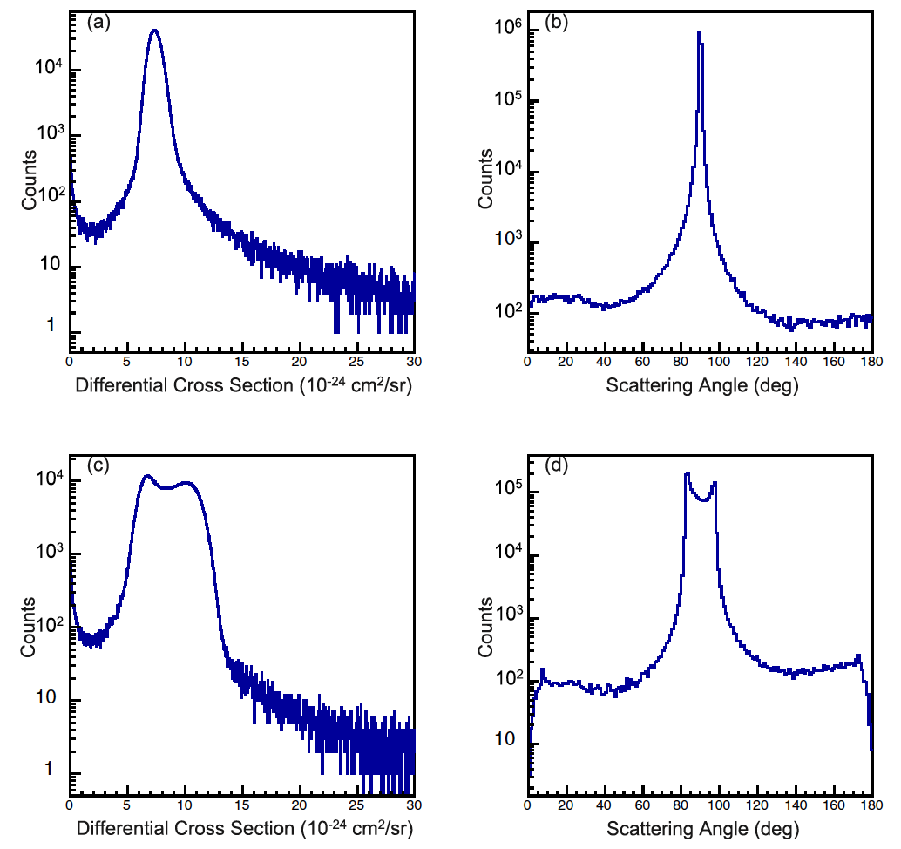
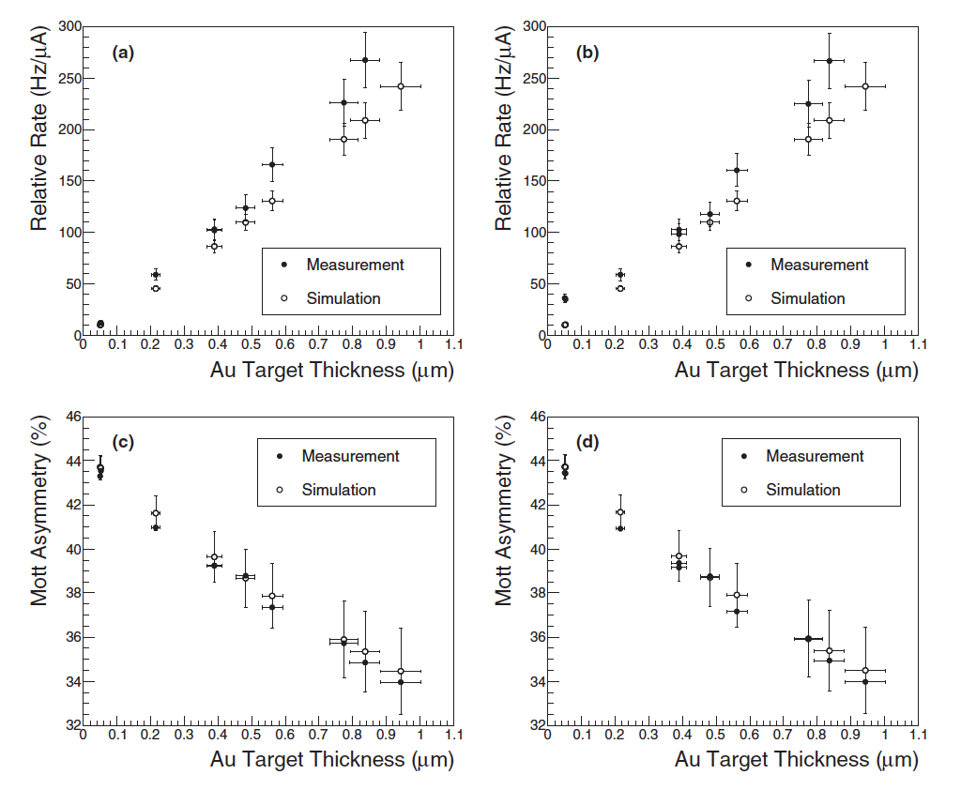
Step 5 – Further techniques & measurements
Various sophisticated Monte-Carlo techniques implemented in Geant4 framework were used to compute Single- and Double- scattering from ”thick” targets into the detector acceptance
Simulations in good agreement with experimental data and confirms Pade functional form from first principles
I refer interested read to the journal article – too many details than can be discussed here
Single
Scattering
Double
Scattering

Slide 22
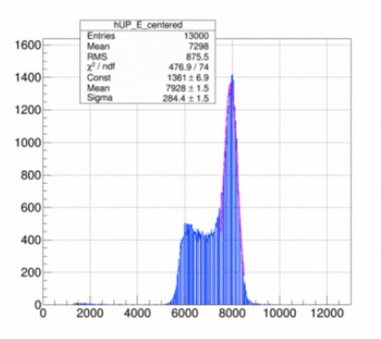
Step 5 – Further techniques & measurements
At JLab we have begun exploring the possibility for a test to further bound radiative corrections by scattering from low-Z carbon targets.
In industry partnership with Euclid Labs began testing diamond targets this summer at CEBAF, now exploring low-background polarimeter capable of operating at high current >100 μA (low cross-section)
Tim – status of AESOP? (left side)
Photo/credit from Eric.

Slide 23
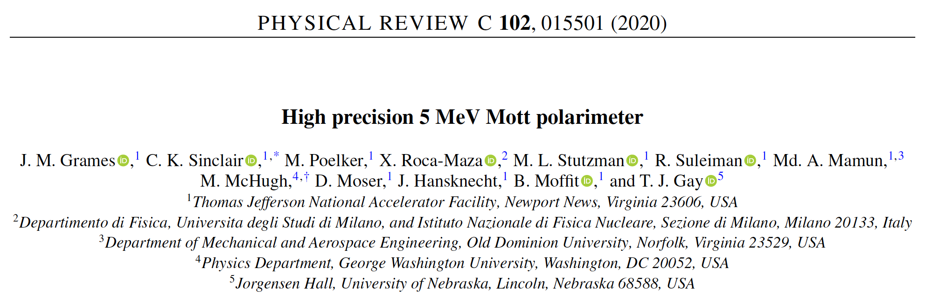
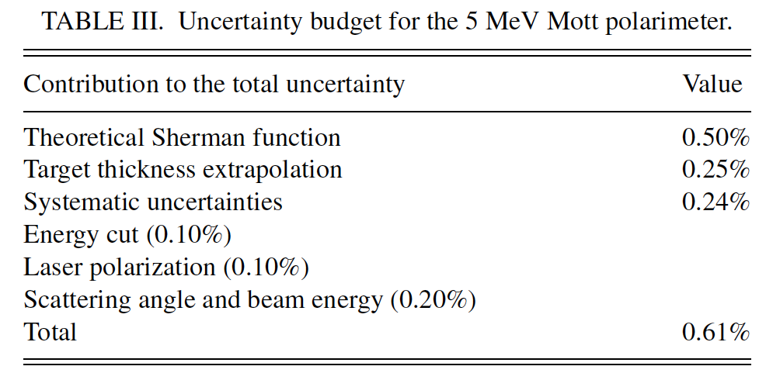
Conclusions
Multi-year effort concluded, results published in Phys. Rev. C in 2020
Great team to work with, a lot of diversity to accomplish our goals
Achieve a total uncertainty of 0.61% on beam polarization with an instrumental precision of 0.25%
Exploring how to further reduce theoretical uncertainty <0.35%, to achieve sub-half-percent accuracy.

