Slide 1
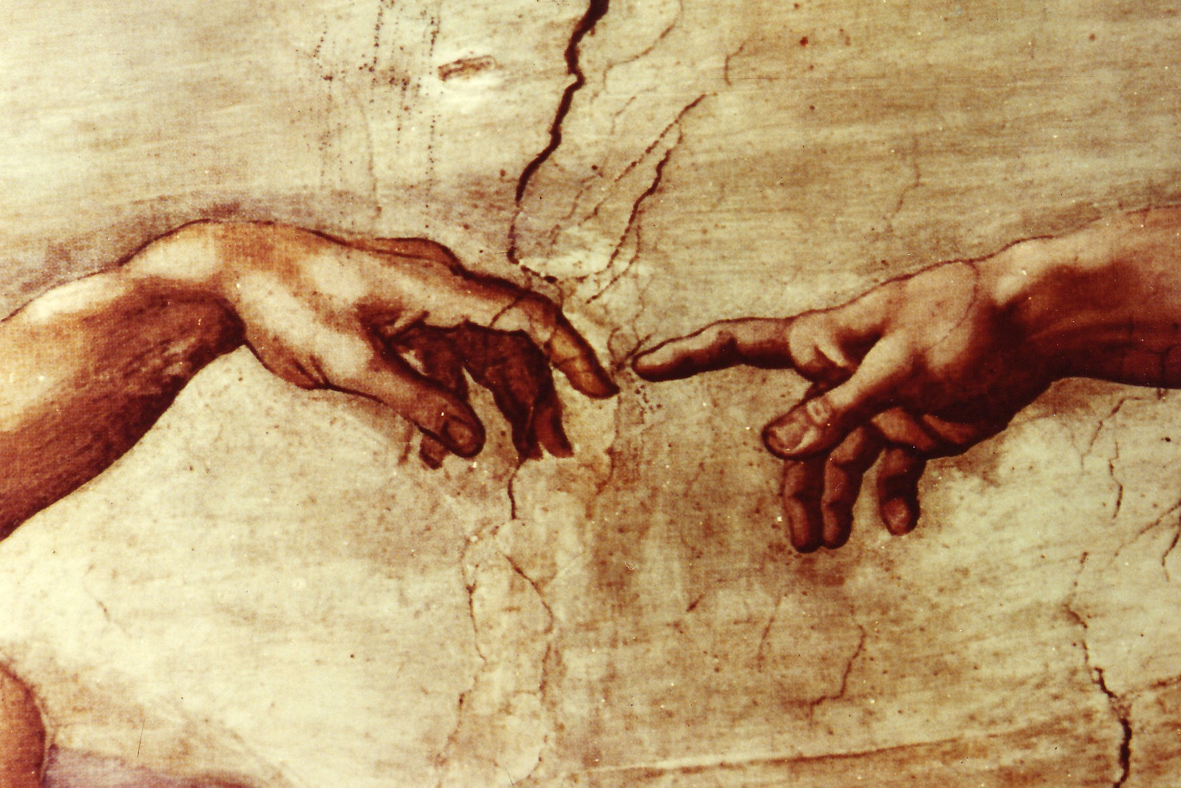

Slide 2


A search for chiral asymmetry in secondary electron emission from cysteine induced by longitudinally-polarized electrons
Timothy Gay, Karl Ahrendsen
University of Nebraska – Lincoln
Ken Trantham
University of Nebraska – Kearney
Dale Tupa
LANL

Slide 3
The problem of biological homochirality and the Vester-Ulbricht Hypothesis

Slide 4
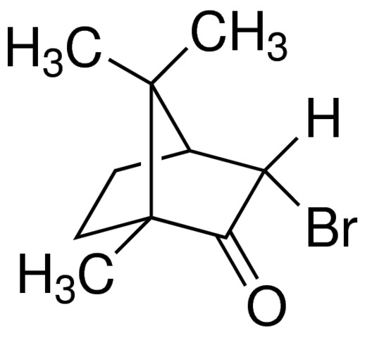
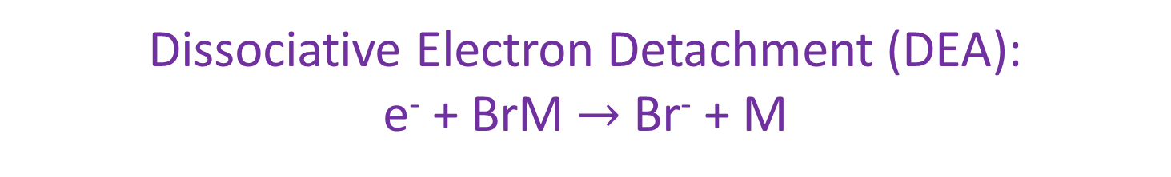
Bromocamphor
“chiral center”
Dissociative Electron Detachment (DEA):
e⁻ + BrM $→$ Br⁻ + M

Slide 5
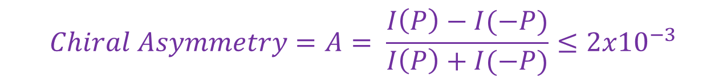
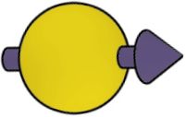
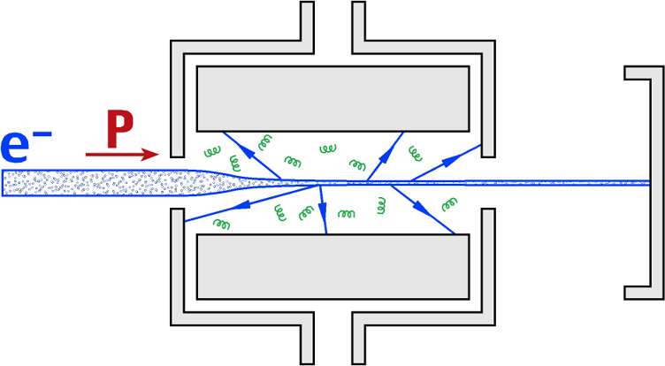
Electron Circular Dichroism in DEA
P_{e}
I(P)
$$Chiral Asymmetry=A= \frac{I\left(P\right)−I(−P)}{I\left(P\right)+I(−P)}≤{2x10}^{−3}$$

Slide 6
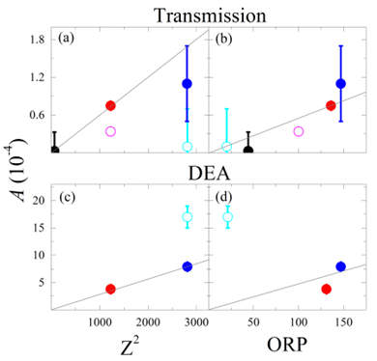
Everything we know so far for the halocamphors…
camphor
3-bromocamphor
3-iodocamphor
3,9-bromocamphor
10-iodocamphor
J.M. Dreiling et al. JPB 51, 21LY01 (2018)

Slide 7
Problems
Organic molecules poison GaAs photocathodes
Halocamphors are chiral, but not relevant biologically
Polarized cosmic beta rays didn’t interact with gaseous targets

Slide 8
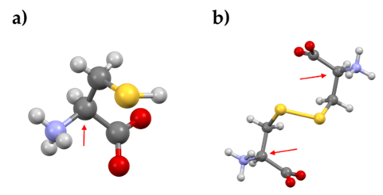
Amino Acids: Cysteine (a) and Cystine (b)

Slide 9
Rb Spin Filter
SOURCE
DIFFERENTIAL PUMPING & TRANSPORT OPTICS
TARGET & POLARIMETER

Slide 11
Optically-Pumped Rb Spin-Transfer Cell

Slide 12
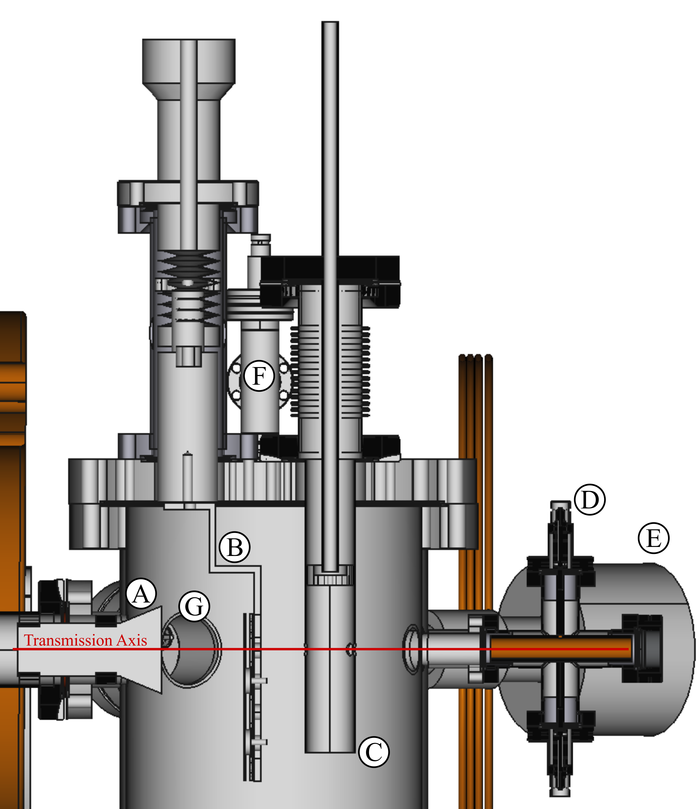
Solid cysteine target cell and He electron polarimeter
A – trochoidal beam deflector
B – cysteine targets
C - He electron polarimeter target cell
D – Faraday cup
E – He optical polarimeter

Slide 13
Problems
Polarized cosmic beta rays didn’t interact with gaseous targets
Energy width of electron beam is wide (2-3 eV)
Solution
Investigate kinetic secondary electron emission

Slide 14

Kinetic Secondary Electron Emission
$$γ=1$$

Slide 15
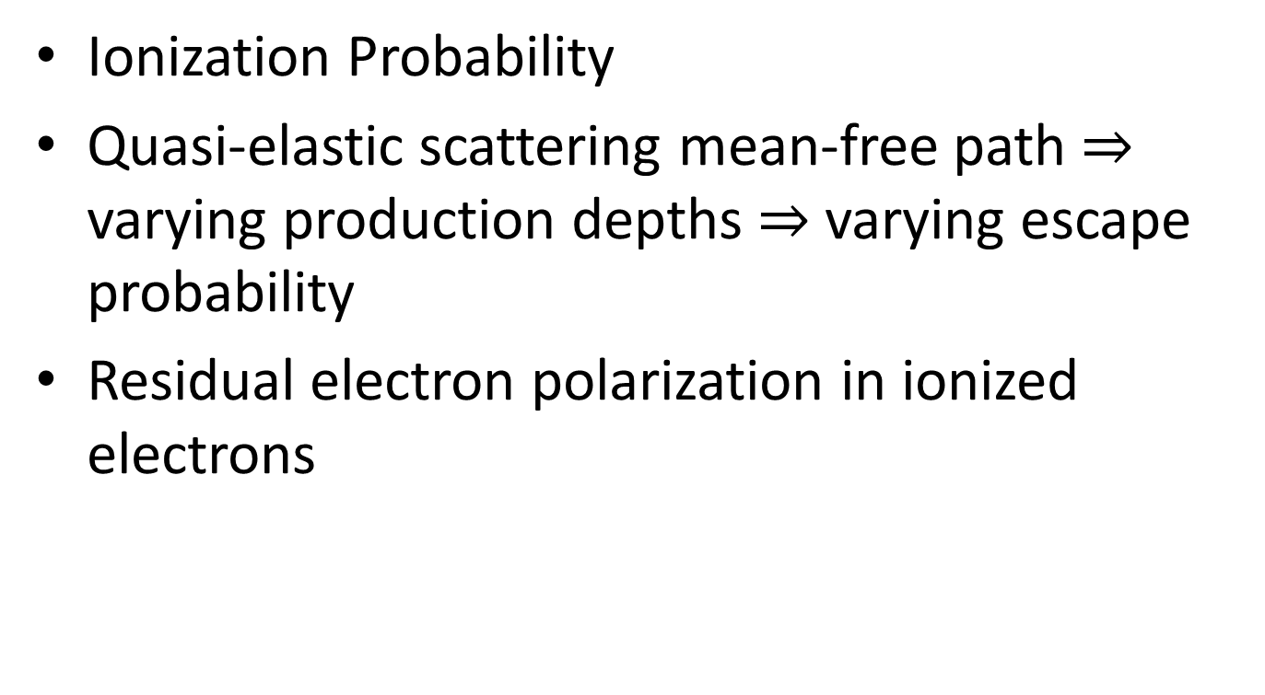
Chiral Dependence of Secondary Electron Emission
Ionization Probability
Quasi-elastic scattering mean-free path $⇒$ varying production depths $⇒$ varying escape probability
Residual electron polarization in ionized electrons

Slide 16
Kinetic Secondary Electron Emission
MgO
Cysteine

Slide 17
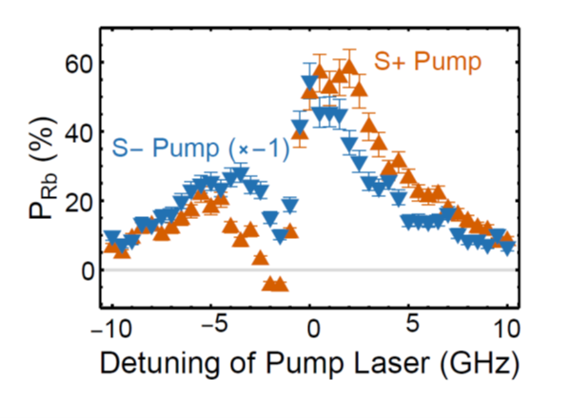
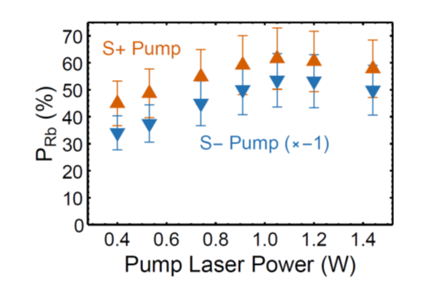
Wavelength Dependence of Rb Polaization
Rb Polarization Saturation

Slide 18
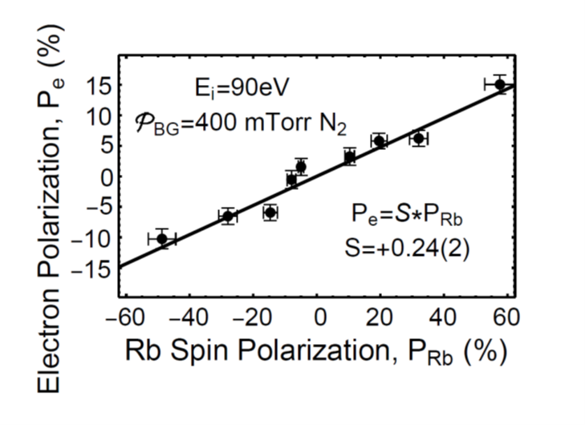
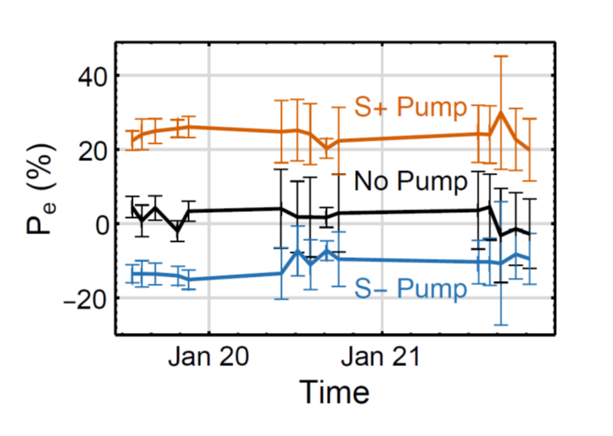
Performance Parameters of the Rb Spin Filter
Spin transfer efficiency
Spin stability over time
P_{e} = 23%
I_{out} > 4 μA
Polarization Figure of Merit – 200 nA
∆E ≈ 1-3 eV
Quasi-turn-key operation

Slide 19
4 Data-Taking Formats
Pumping laser on resonance; -9 V on target; TRUE ASYMMETRY
Pumping laser on resonance; +54 V on target; FALSE ASYMMETRY
Pumping laser off resonance; -9 V on target; FALSE ASYMMETRY
Pumping laser off resonance; + 54 V on target; FALSE ASYMMETRY

Slide 20
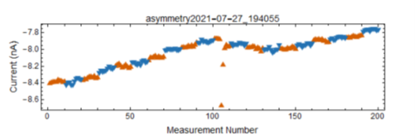
“Raw” Data
Day-to-Day Final Data; A_{voltage} = A_{on}-A_{off}

Slide 21
Final Results
A_{SEE} < 10⁻³ for cysteine at 140 eV
A_{DEA} ranges from 1 x 10-4 – 2 x 10-3 for the halocamphors

Slide 22
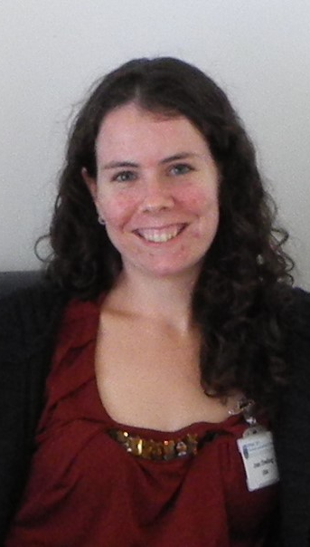
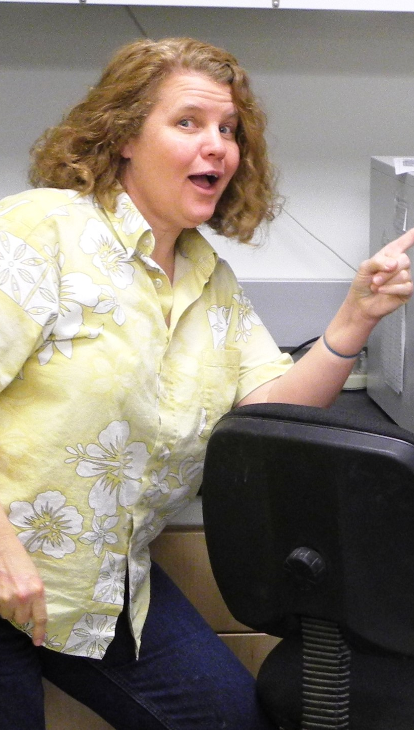
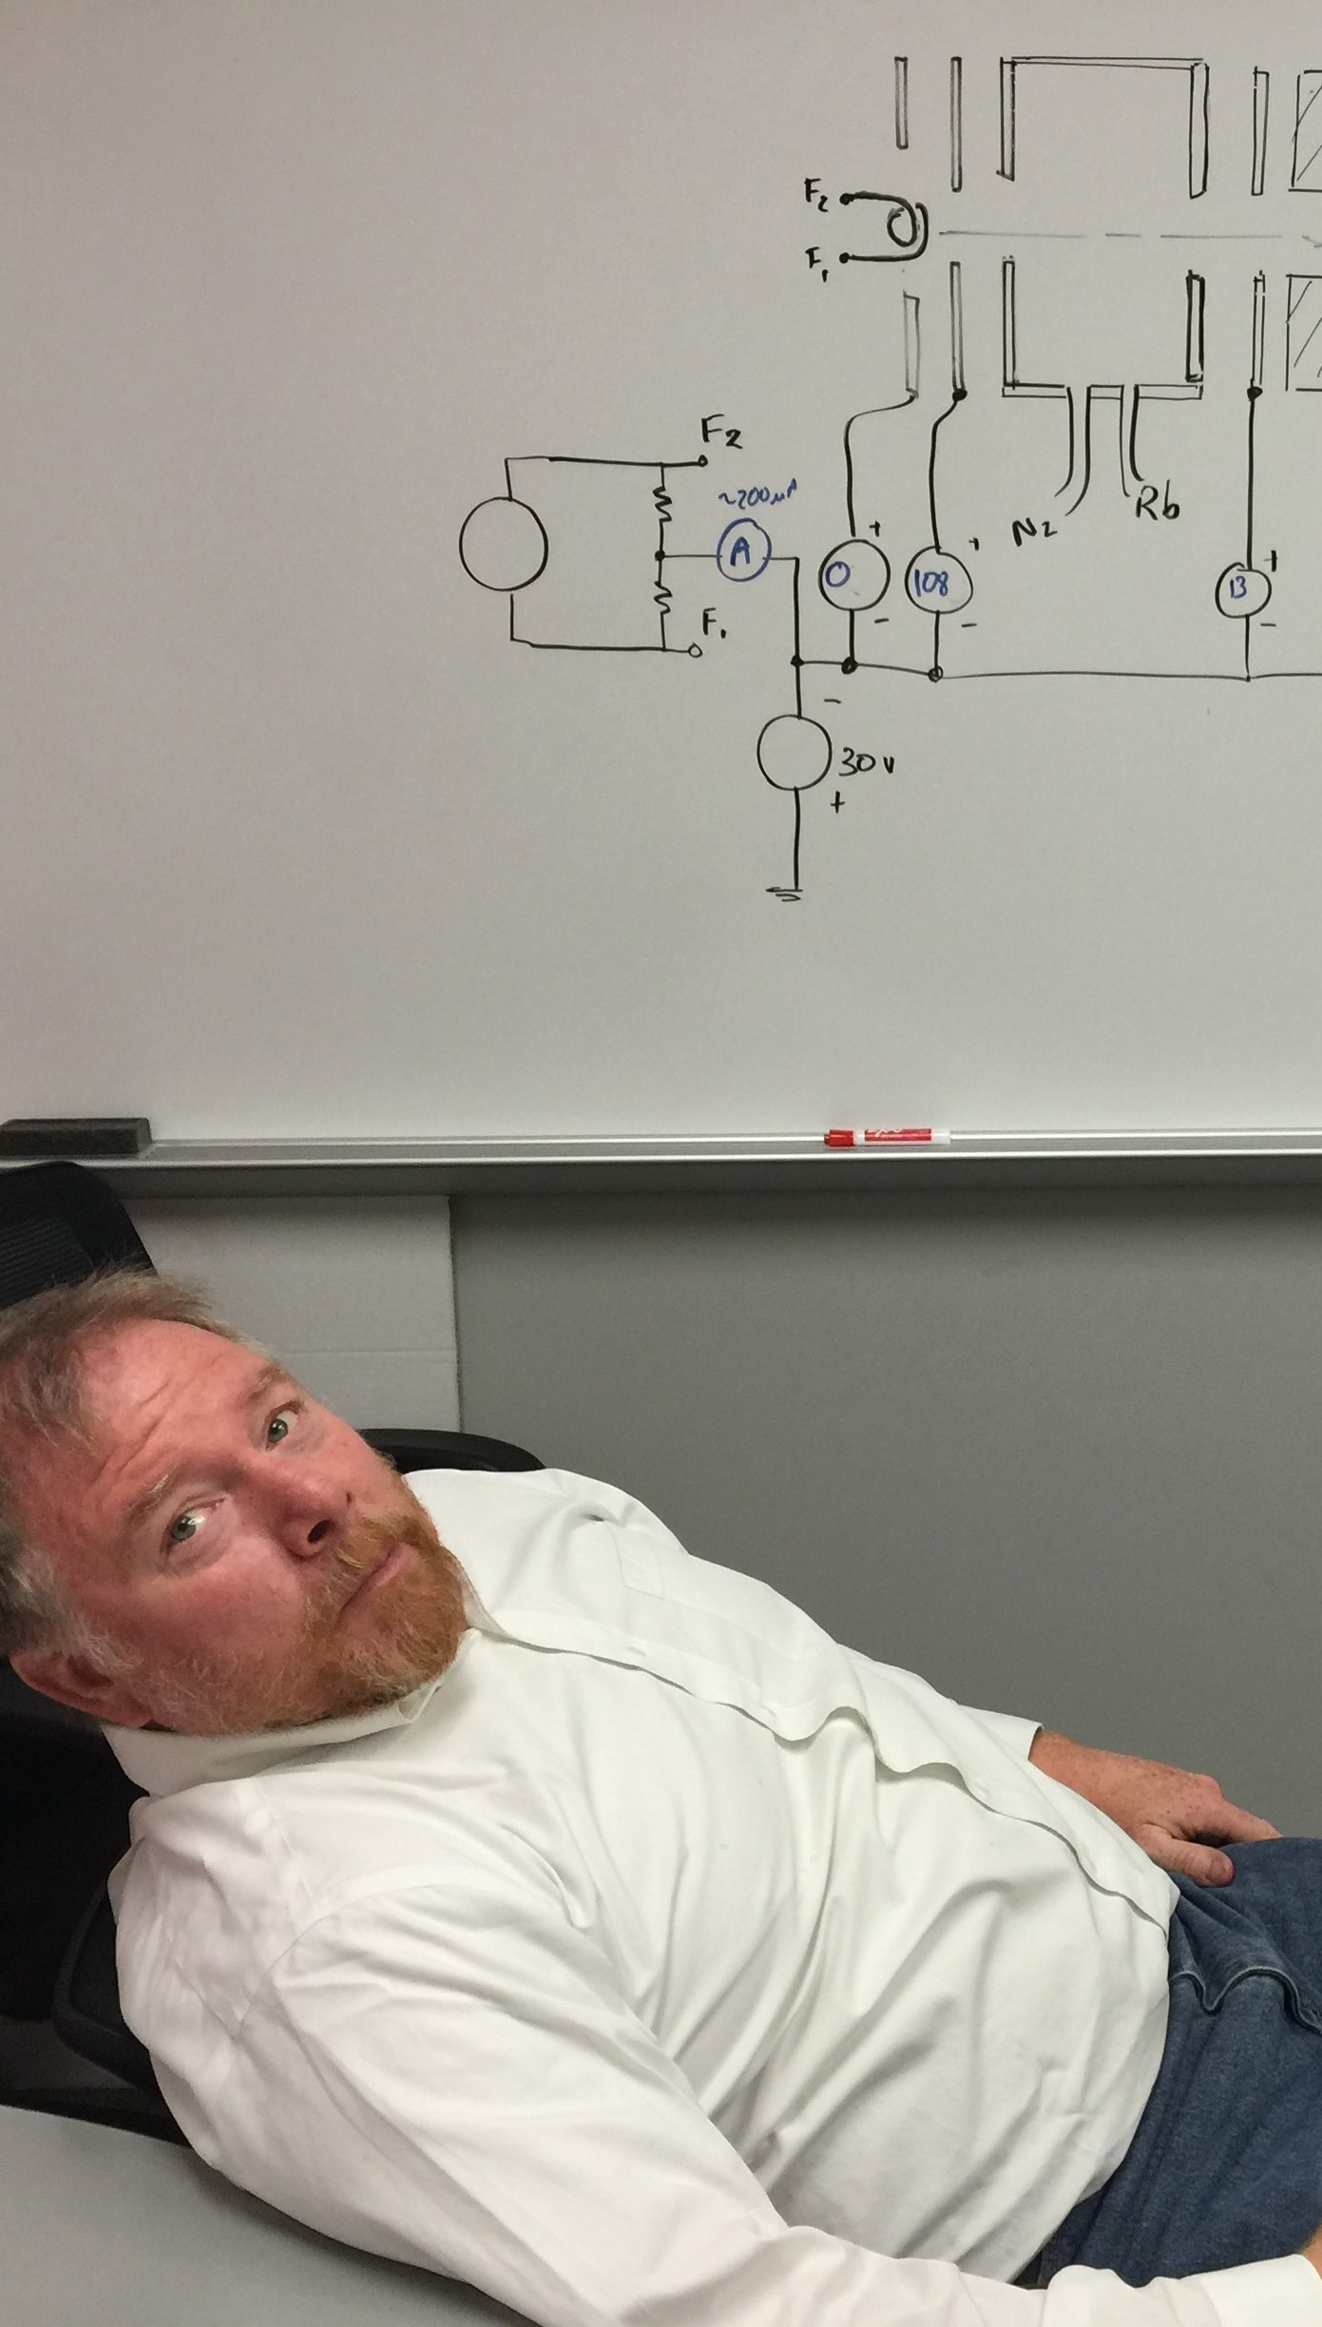
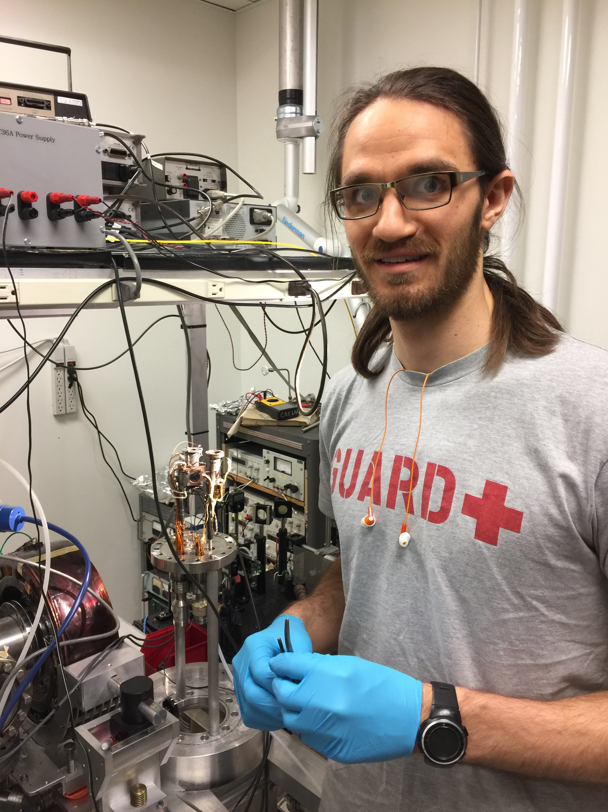
Co-Perpetrators
Dreiling
Tupa
Ahrendsen
Trantham

