Slide 1
A fast source of polarized electrons
T.J.Gay, E.M.Brunkow, H.Batelaan, and E.R.Jones
University of Nebraska-Lincoln

Slide 2
Why do we want fast, polarized electron pulses?
Movies of magnons
Spin exchange dynamics of chemical reactions
Hanbury-Brown/Twiss experiments
…?

Slide 3
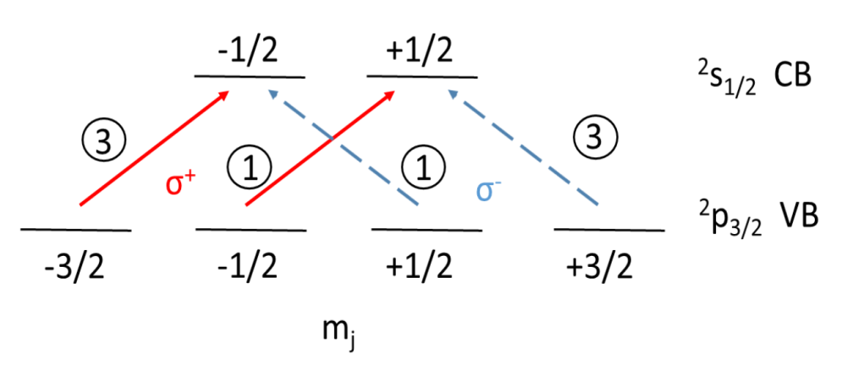
How to make polarized electrons: NEA GaAs
Direct band gap photonic excitation in GaAs
Valance band (VB)/conduction band (CB)
Zeeman diagram

Slide 5
The state-of-the-art: Negative Electron Affinity (NEA) GaAs
10⁻¹¹ Torr
Extremely susceptible to contamination (e.g., CO₂)
Learning curve: 6 months
2 weeks (minimum) turnaround

Slide 7
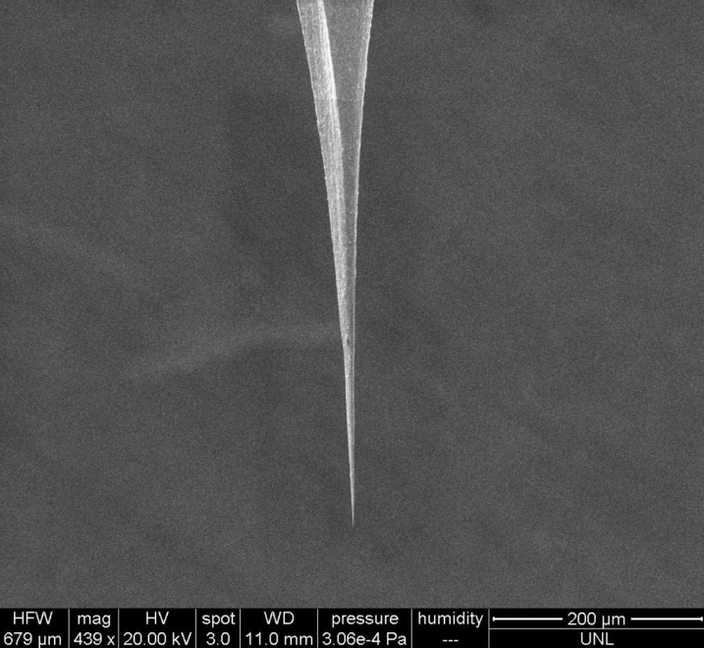
Tips! Field Emission!
Tips are fast
Tips are bright
Magnetic field emission tips can be polarized (only CW sources to date)

Slide 8
REMPI: the condensed matter version!

Slide 9
How to make polarized electrons: NEA GaAs
Direct band gap photonic excitation in GaAs
Valance band (VB)/conduction band (CB)
Zeeman diagram

Slide 10
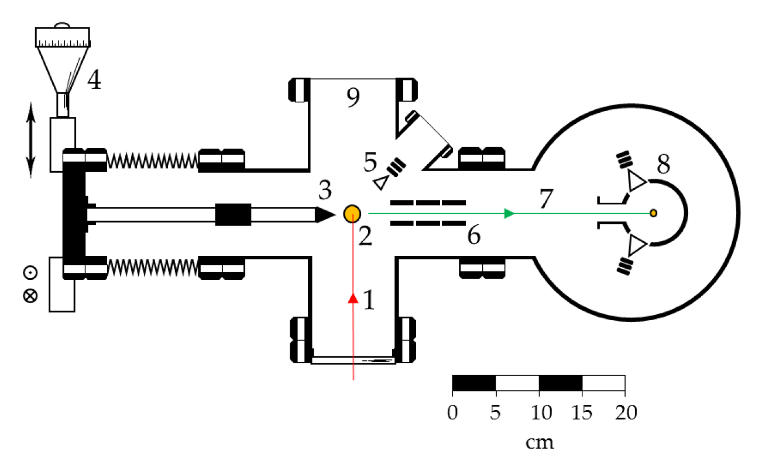
APPARATUS

Slide 11
Tip Source Details

Slide 12
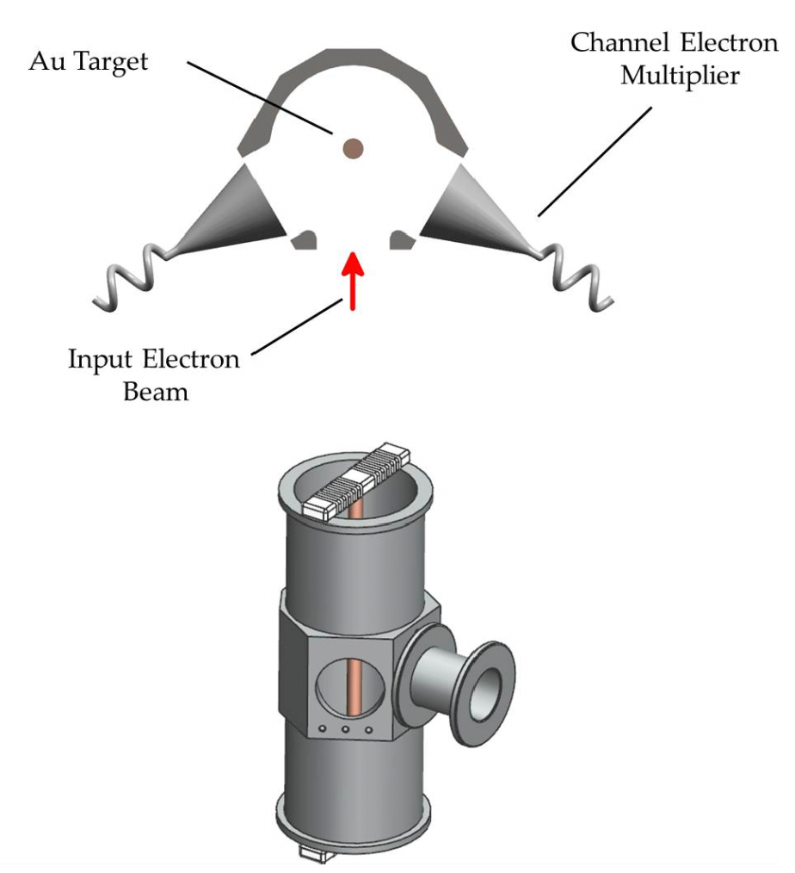
Mott polarimetry
Clayburn et al. RSI 87, 053302 (2016)

Slide 13
analyzing power
efficiency
“figure of merit”

Slide 14
A GaAs “tip”

Slide 15
Shards up close...

Slide 16
Laser Parameters
Ti:Saph; ~785 nm
~75 fs pulse duration
~ 2 nJ/pulse1

Slide 17
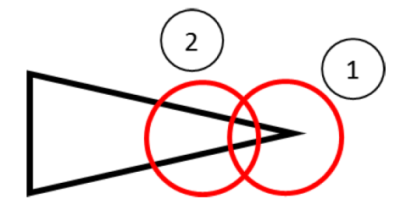
Morphology and emission rates

Slide 18
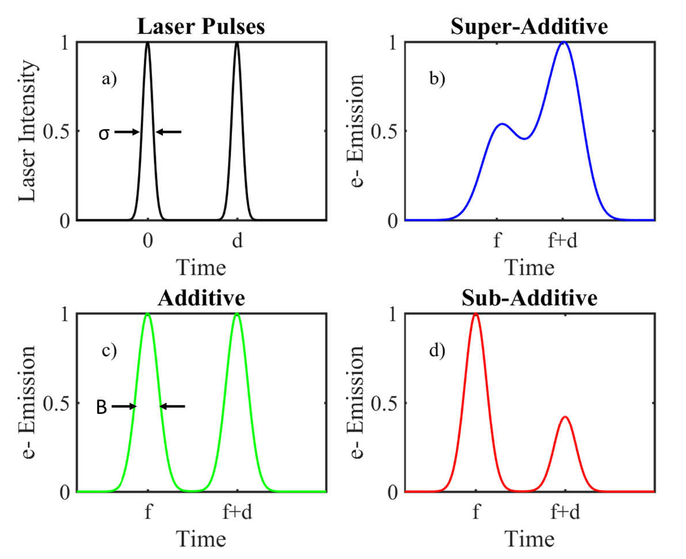
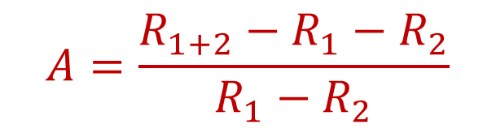
ADDITIVITY - A
$$A=\frac{R_{1+2}−R_{1}−R_{2}}{R_{1}−R_{2}}$$

Slide 19
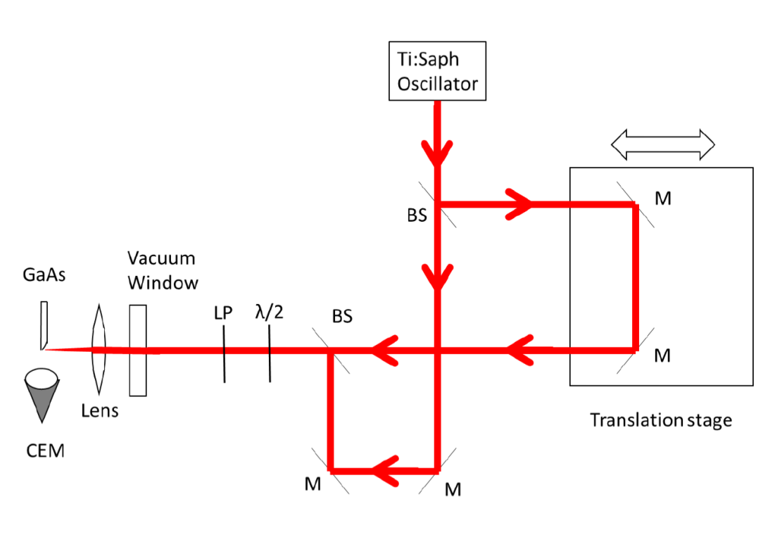
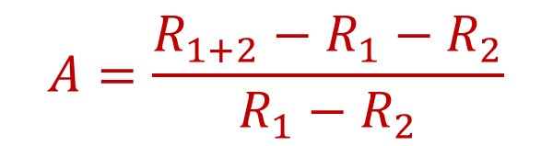
ADDITIVITY - A
$$A=\frac{R_{1+2}−R_{1}−R_{2}}{R_{1}−R_{2}}$$

Slide 20
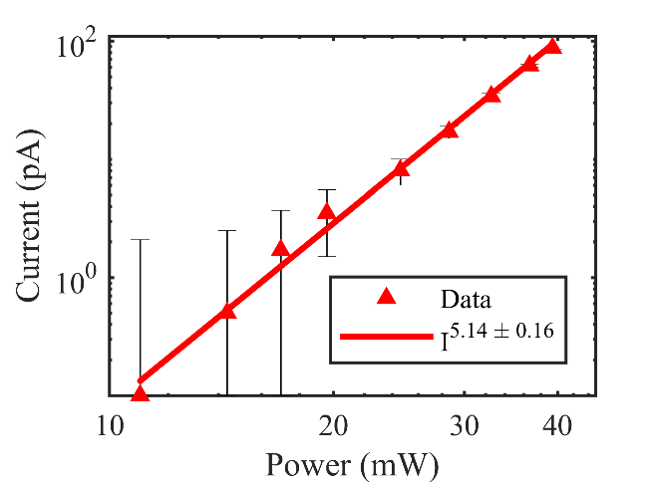
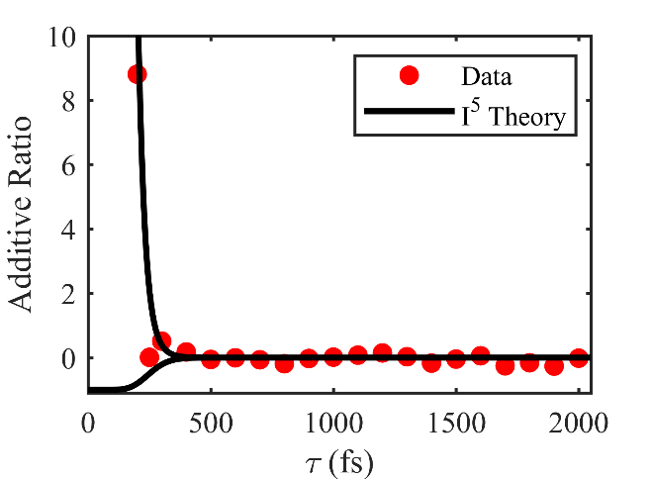

Fast?
Polarized?

Slide 21
Fast?
Polarized?

Slide 22
Next Steps: Chiral Pd Nanostructures, GaAs Tip Arrays, and Ion-Milled Nanojavelins!
E. Schubert et al., Appl. Phys. A 81, 481 (2005)
K. Yamaguchi and S. Tada, J. Electrochem. Soc. 143, 2616 (1996)

Slide 23
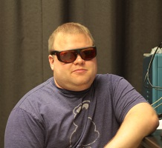
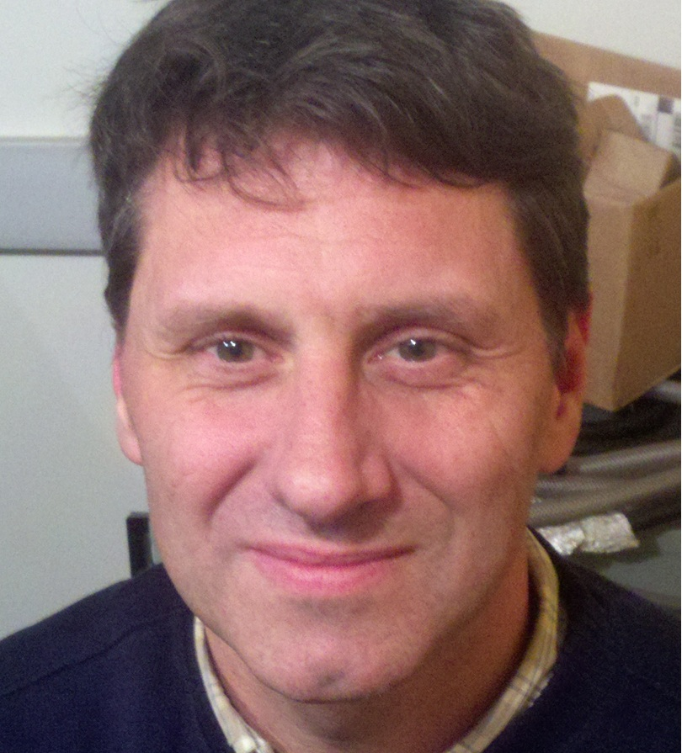

Messrs. Evan Brunkow, Herman Batelaan, and Eric Ryan Jones

