Slide 1
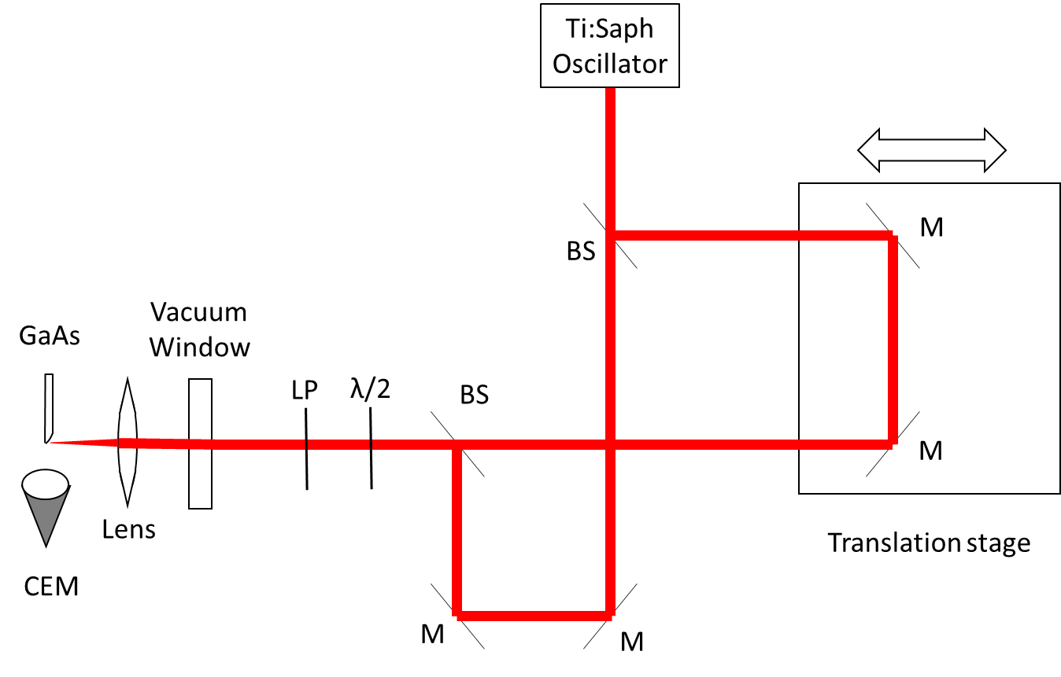
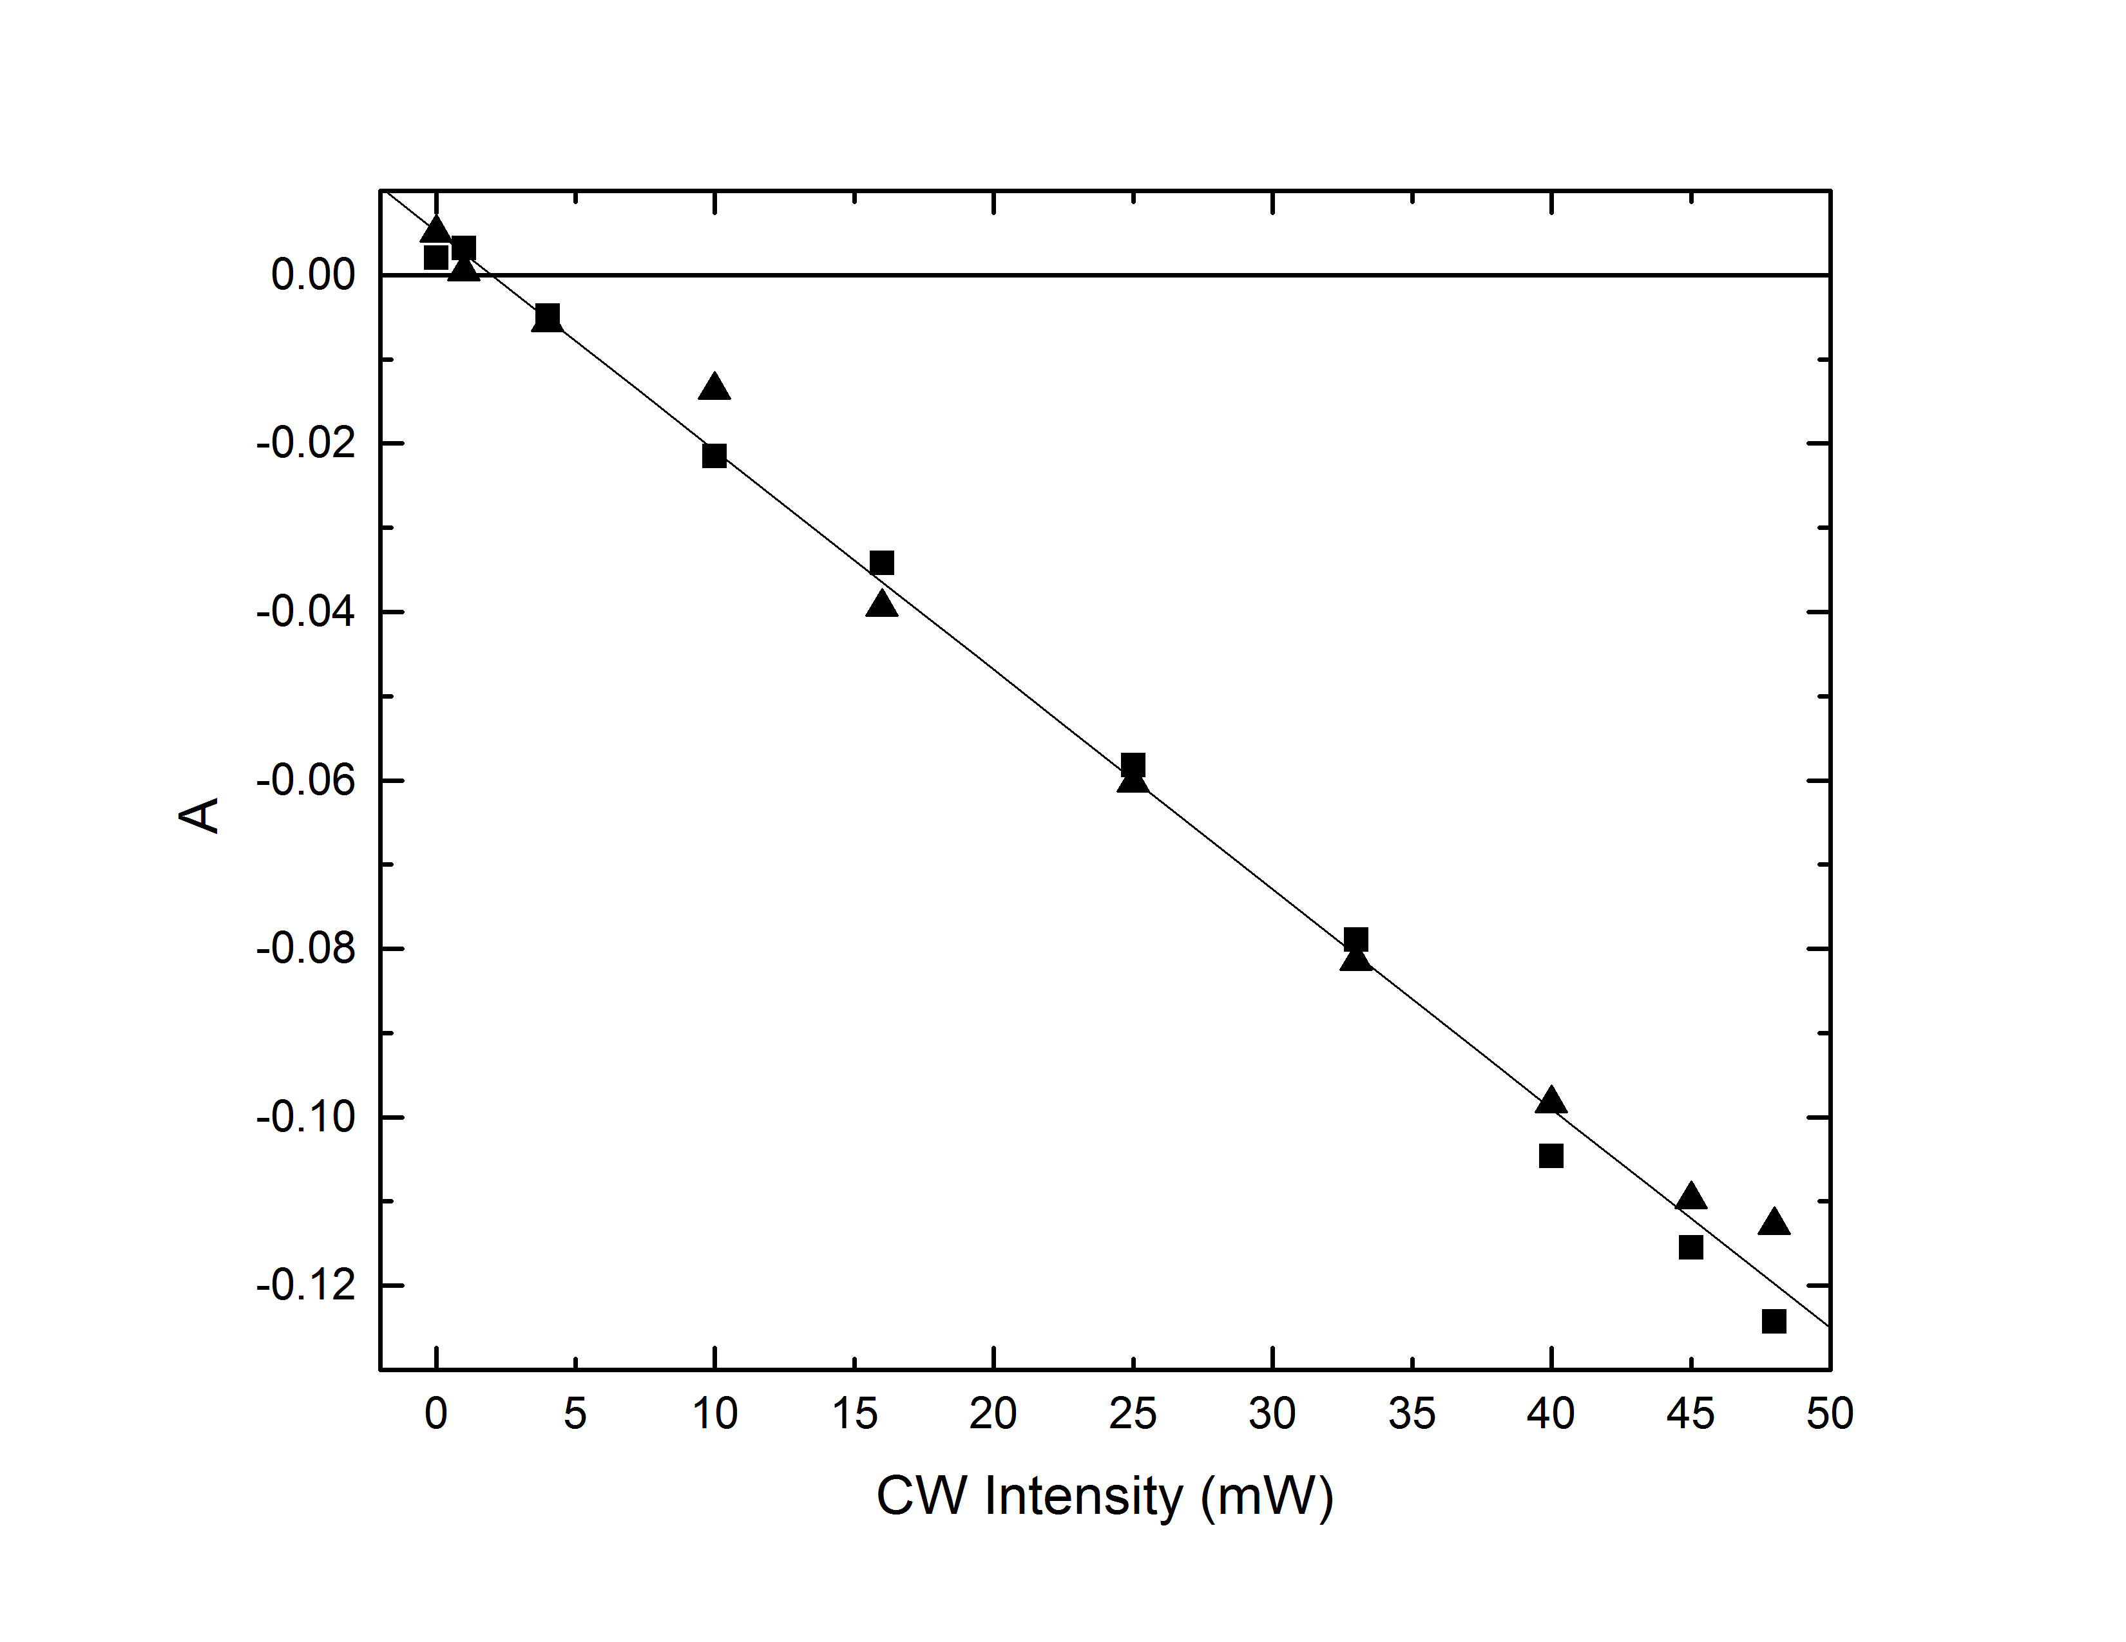
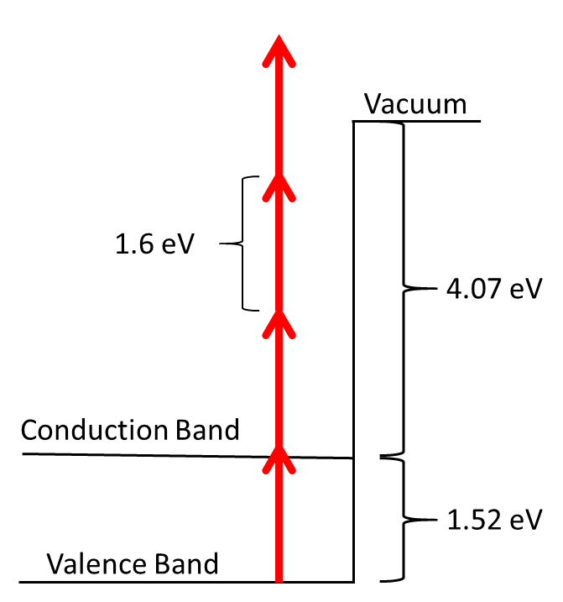
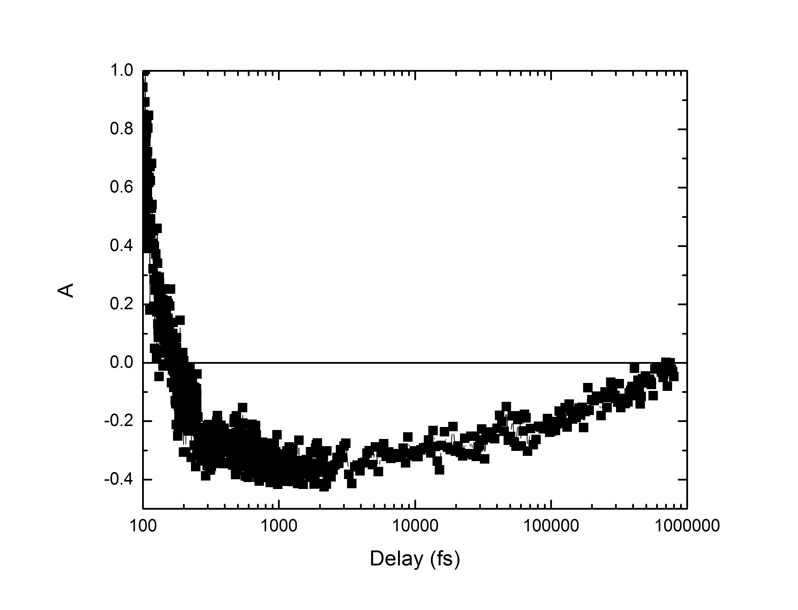
Sub-Additivity in Electron Emission from GaAs
E. Brunkow¹, N. B. Clayburn¹, M. Becker¹, E. Jones¹, H. Batelaan¹, and T. J. Gay¹
¹ Department of Physics and Astronomy, University of Nebraska, Lincoln, NE 68588-0299
Introduction
If the emission is fast, but there is another slow process that is dependent on the lifetime of the excited state that inhibits electron emission, sub-additivity would result. This would imply that the first pulse somehow changes the properties of the GaAs so the second pulse emits fewer electrons.
As can be seen in Figure 2b, our value for A is negative for delays of 200fs up until approximately 1ns. This follows the scenario of a fast emission with a slow secondary process.
Excited State Interaction
We have shown in the past that when two spatially overlapped, but temporally delayed laser pulses are incident on a sharp feature of GaAs, the crystal emits fewer electrons than the two pulses would have emitted by themselves, even if the pulses are delayed by up to significant fractions of a ns [1,2]. We refer to this phenomena as “sub-additivity”. The electron emission is proportional to I³ for our measurements, where I is the laser intensity. We present evidence that sub-additivity occurs due to electrons being excited to the conduction band by the first pulse. We also present our evidence for why we believe this is a fast process.
To show that sub-additivity is caused by the occupation of the excited state, we aligned a CW laser to be co-linear with the pulsed laser. This allowed electrons to be continuously filling the excited state. Figure 3 shows how our sub-additivity becomes more negative as the excited state is more and more populated by the increasing power of the CW laser.
Fast Process
Figure 1 shows our setup for measuring the sub-additivity. We define sub-additivity as $A=\frac{S_{both}−S_{Pump}−S_{Probe}}{S_{Pump}+S_{Probe}}$, where S is the number of electrons counted when both beams, only the pump beam, or only the probe beam are incident on the GaAs.
Figure 2a shows a schematic of the GaAs energy levels. We believe that the exponent of the intensity dependence for our intensities comes from the three photons needed to emit an electron from the excited state.
If the process is slow (>1ns), we would calculate a value for each S based on the emission rate of electrons as a function of total laser intensity incident on the crystal. For S_{both}, the emission rate would be proportional to (2I)³ since there are two pulses incident. The other values of S would be proportional to I³ since each has only a single incident pulse. This gives us a value for A that is positive for all delays above 200fs.
If the emission process is faster than the pump-probe pulse delay, A would be zero since S(2I)=2S(I). This would imply that when each pulse reaches the crystal, the GaAs is in the same condition as if it had not been hit by previous pulses.
Fig. 1. Experimental setup. Pulses pass through a 50/50 beamsplitter (BS) which sends each half along a different path, one of which has a variable path length. The two halves are then recombined co-linearly using mirrors (M) and another BS. The recombined beam passes through a half-wave plate (λ/2) and a linear polarizer (LP). The pulses are sent into the vacuum chamber and focused onto a GaAs crystal. Emitted electrons are collected by a biased channel electron multiplier (CEM).
Fig. 3. CW laser aligned collinearly with pulsed laser. As the CW power increases, the sub-additivity becomes more negative due to more electrons being pumped to the excited state.
Next Steps
Our next step will be to measure the polarization of the emitted electrons using a Mott polarimeter to see if the interaction with the excited state is in fact causing an electron polarization. If there is a polarization, we can then start tests to measure how fast the emission process is.
References
(a) (b)
[1] E. Brunkow et al., Bull. Am. Phys. Soc., 58, 38 (2013).
[2] E. Brunkow et al., Bull. Am. Phys. Soc., 60,182 (2015).
*Funding: NSF PHY-1505794, NSF EPSCoR Grant IIA-1430519, and NSF PHY-1306565.
Fig. 2a. Diagram of GaAs energy levels. (b) Experimental data showing that A goes below zero for delays between 200fs and 1ns.

