Slide 1
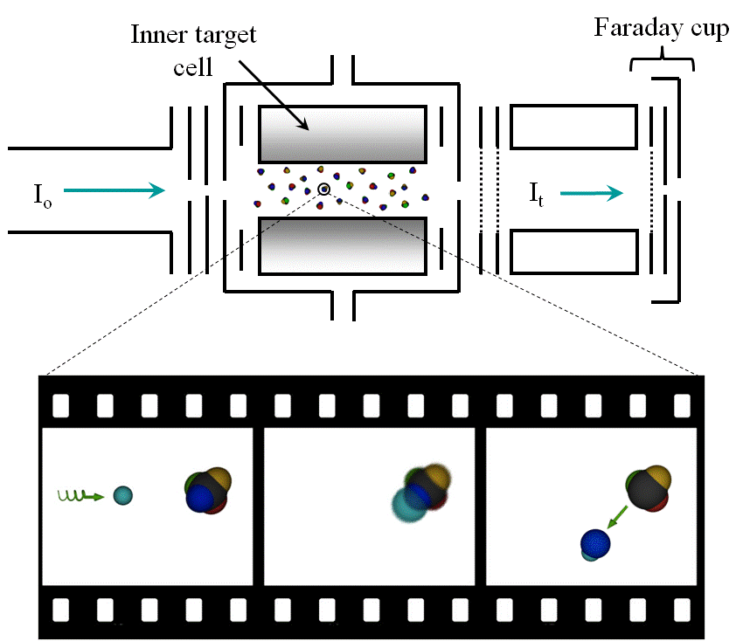
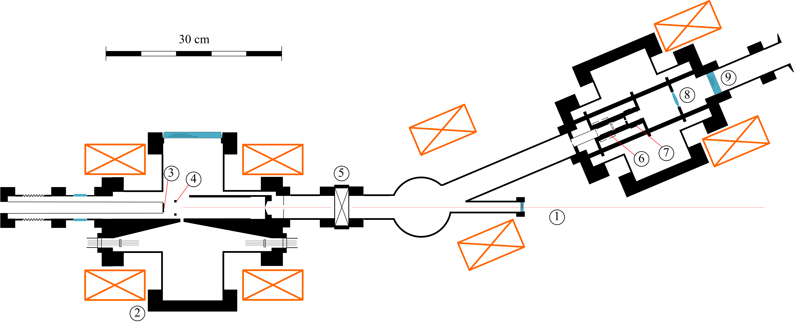
Asymmetric Interactions between Chiral Molecules and Spin-Polarized Electrons
J. M. Dreiling and T. J. Gay
Department of Physics and Astronomy, University of Nebraska-Lincoln, Lincoln, NE 68588-0111
Experiment
In this experiment, spin-polarized electrons with alternating forward and backward longitudinal spins interact with a vapor of chirally-pure molecules. The experimental apparatus is shown in Fig. 1.
1
2
3
Figure 2. Illustration of electron/molecule interactions. Top: Target, showing the incident (I_{o}) and transmitted (I_{t}) electron beams, the target cell structure, the Faraday cup assembly used to measure the transmitted beam, and other electrostatic lens elements and apertures. Bottom: Depiction of the DEA process with (1) a spin-polarized electron incident on a chiral molecule, (2) the formation of a temporary negative ion resonance, and (3) the breaking of the bond yielding a negative ion and the residual radical. In a transmission experiment, the current collected on the Faraday cup is monitored. In a DEA experiment, the Br⁻ anions are detected as a negative electrical current on the walls of the inner target cell.
Figure 3. Transmission asymmetry of spin-polarized electrons through chirally-pure bromocamphor and comparison with the results of Mayer et al.
Figure 1. 1) laser beam; 2) guiding magnets; 3) GaAs photocathode; 4) cesiators; 5) gate valve; 6) chiral target cell; 7) optical polarimeter target cell; 8) lens; 9) to optical polarimeter.
The asymmetry is defined as
$A={\left(\frac{I_{+}−I_{−}}{I_{+}+I_{−}}\right)}_{L}−{\left(\frac{I_{+}−I_{−}}{I_{+}+I_{−}}\right)}_{R}$,
where I₊ (I₋) is the current measured for positive (negative) electron spins, and “L” (“R”) correspond to the left- (right-) handed chirality of the target molecules. We consider the asymmetry for two different electron/molecule interactions: electron transmission and dissociative electron attachment.
Results
We first measured A for the transmission of spin-polarized electrons through a vapor of chirally-pure bromocamphor at several incident electron energies. As a systematic check, the data were taken using two different settings of the final quarter-wave plate that polarizes the laser light. This flips the overall sign of the electron polarization for a given optical configuration. Our results are compared with the measurements of Mayer et al. [2] (scaled for our asymmetry definition, electron polarization, and beam attenuation) as shown in Fig. 3. Additionally, the results of our measurements of A for DEA are shown in Fig. 4. For DEA, we also made an asymmetry measurement using two samples of racemic bromocamphor (equal amounts of left and right molecules, thus zero net chirality), which yielded a zero asymmetry as expected.
Electron/Molecule Interactions
Transmission: In an experiment considering the asymmetry in the transmission of spin-polarized electrons through chiral molecules, the current transmitted through the gas of molecules and collected on the Faraday cup is monitored (see Fig. 2). We look for a helicity-dependence of this current.
Dissociative Electron Attachment (DEA): In a DEA process, an incident electron resonantly excites a temporary anion state of the molecule. The molecule then breaks apart, with one of the fragments retaining the negative charge of the electron [1]. This is illustrated in the bottom part of Fig. 2. A chiral asymmetry in the DEA process is detected as a spin-dependent negative ion current as collected on the inner target cell walls. In the case of bromocamphor, the negative ion that is detected is Br⁻.
Figure 4. The DEA asymmetry as a function of incident electron energy. The energy scale is defined such that 0 eV corresponds to the peak in the derivative of the Faraday cup current. Thus, “negative” energies correspond to the high energy tail of the incident electron beam, which had an energy width (FWHM) of ~0.6 eV. Uncertainties are determined by taking the standard deviation of the mean of the individual asymmetry measurements. We estimate the uncertainty in the energy to be ~0.1 eV.
Conclusions
We have confirmed the results of Mayer et al. for the transmission of spin-polarized electrons through chirally-pure bromocamophor. Additionally, we have also observed chirally-dependent dissociative electron attachment when spin-polarized electrons are incident on bromocamphor molecules. The unambiguous identification of such handedness in a destructive molecular process represents validation of the Vester-Ulbricht hypothesis [3].
[1] Christophorou, L.G., McCorkle, D.L. & Christodoulides, A.A. Electron-Molecule Interactions and Their Applications (ed. Christophorou, L.G.) 477 (Academic, Orlando, 1984).
[2] S. Mayer, C. Nolting, and J. Kessler, J. Phys. B: At. Mol. Phys. 29, 3497-3511 (1996).
[3] F. Vester, T.L.V. Ulbricht, and H. Krauch, Naturwissenshaften 46, 68 (1959).
We gratefully acknowledge the help of E.T. Litaker and Profs. K.W. Tranthan and P.D. Burrow. This project is funded by NSF Grant PHY-1206067.
Notes:
1

